Slide 1
valantic References
Slide Library
Version 009 | Date: 2024-04-03

Slide 2
Notes on reference slides
Version V008 – Last update: 2023-09-14
  For each reference customer, there is an illustrated, abridged version that can be animated by double-clicking it, as well as a more detailed, long version without pictures or animations. The abridged and long versions can also be used together.
  The images in the abridged versions extend beyond the edge of the slides – the reason being to allow you to "grasp" them if you would like to insert an image of your own. This allowed us to position the elements accurately when we created them. You can't see this in presentation mode.
  If you provide the slides to your customers, it is best to do so in PDF format.
  Depending on the size of the view, the slides' elements could appear to be positioned inaccurately and jump. This can be due to "scaling" of slides which are deemed to be "too large", but not of those which are deemed to fit or are smaller. If this bothers you, select the zoom setting of your view so that also the slides with the overlapping images are fully displayed. This solves the scaled view problem.
  The comments panel contains the link to the respective case study on our website.
  New references are added regularly to this chart pool.
Notes:
Change 11.07.2022 - Please do not use Case Study Winkels any more - therefore deleted here in the slide deck.

Slide 3
Table of Contents
  Slide 04 | Digital Strategy & Analytics
  Slide 33 | SAP Services
  Slide 61 | Smart Industries
  Slide 84 | Customer Experience
  Slide 131 | Further references

Slide 4
Digital Strategy & Analytics
References

Slide 5


Networked Financial Planning Boosts Efficiency at Swarovski
Case Study
Crystal glass PROCESSING
valantic ensures crystal-clear finance planning at Swarovski
  Swarovski, one of the leading brands for cut crystal glass jewellery and accessories, wanted to improve agility and interconnectivity within its financial planning.
  valantic implemented a solution based on SAP Business Warehouse as a consolidated data source, a powerful planning engine as a planning platform, and a predictive forecast from the Google Cloud Platform.
  The benefits: Huge efficiency gains, a sharp drop in manual tasks and error rates, and improved transparency and forecasting accuracy.
  Greater agility of the forecasting and planning processes.
        Swarovski now benefits from fast and accurate forecasts for making smart business decisions.
Notes:
https://www.valantic.com/en/case-studies/connected-financial-planning-swarovski/

Slide 6



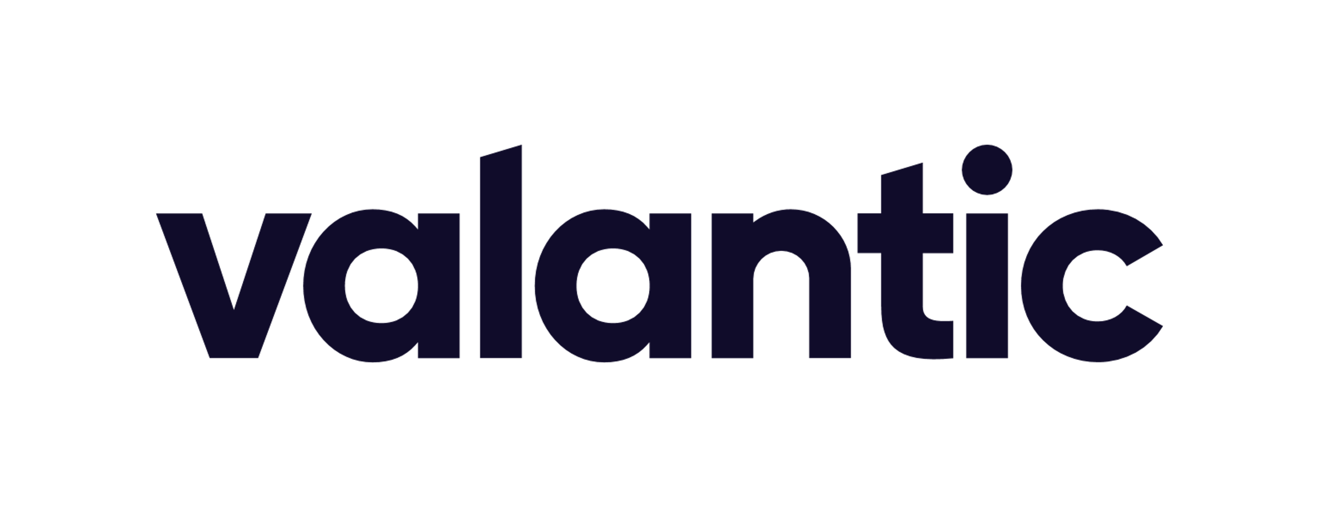
Swarovski
Case Study
CRYSTAL GLASS PROCESSING
To redesign the financial planning and forecasting system using artificial intelligence
Implementation of an agile strategic and operational planning system based on a powerful solution using multiple vendors’ technologies.
Challenge
Consulting approach & technology
The interconnected financial planning system serves Swarovski as a reliable information basis for making smart, successful business decisions.
Benefits for the customer
Forecasting accuracy
Fewer error sources
Forecasting agility
Notes:
https://www.valantic.com/en/case-studies/connected-financial-planning-swarovski/

Slide 7


On - Single Source of Truth for Their Planning Processes
Case Study
Sports & Fashion
valantic ensures that everything runs smoothly
at On
        On uses Anaplan to improve the transparency, networking, and forecasting accuracy of their planning processes.
  On is a Swiss premium supplier of shoes, clothing and accessories for high-performance running and outdoor activities and has customers in over 60 countries.
  valantic implemented a centralized, global data hub for On based on the Anaplan planning solution.
  valantic worked together with On to design visual reports and dashboards that enable planners to view and process information in the desired form.
  They also implemented access control mechanisms that allow planners to access information directly, thereby reducing the amount of support required.
  In a future project phase, On intends to consolidate and integrate its master data to reduce manual workloads and further optimize its planning.
Notes:
https://www.valantic.com/en/case-studies/connected-planning-at-on/

Slide 8


On – Single Source of Truth for Their Planning Processes
Case Study
Sports & Fashion
To implement a transparent planning platform that serves as a single source of truth and can adapt flexibly to market changes.
After analyzing the a status quo, valantic implemented in just five weeks a lean, underlying process in Anaplan, as well as a data hub that serves all of the Anaplan models at On.
Challenge
Consulting approach & technology
On now benefits from a reduced number of manual tasks, improved data consistency and transparency, and more efficient
interdepartmental collaboration.
Benefits for the customer
Reduced support overheads
Flexibility
Transparency
Notes:
https://www.valantic.com/en/case-studies/connected-planning-at-on/

Slide 9

Rescue Following a
Ransomware Attack
Case Study
E-Commerce
valantic ensures that an e-store isn’t sold down the river by cybercriminals
  An e-store has been targeted by a ransomware attack: All of the systems shut down, all of the data on the file servers are encrypted – nothing works anymore.
  The goal: To get all systems up and running again as quickly as possible.
  valantic performs a status check, identifies the mission-critical business processes and initiates countermeasures.
        “Mission Impossible” was successful: After seven days, the computers were powered up again, and after a further eleven days the logistics chain was running smoothly once more.
Notes:
https://www.valantic.com/en/case-studies/rescue-of-the-company-after-a-cyber-attack/

Slide 10
Rescue Following a Ransomware Attack
Case Study
E-Commerce
A cyber attack had encrypted the data and brought the entire IT system to its knees – a disaster for the targeted company. All of the systems had to be got up and running again as quickly as possible.
valantic’s proven approach: Initiate
emergency operations – technical and business disaster management – interim IT management – structural setup of a long-term IT strategy.
Challenge
Consulting approach & technology
All of the IT systems were soon up and running again, the economic damage was minimal, and the company is now better protected against cyber attacks in the long term.
Benefits for the customer
Protection against new attacks
Disaster management
Business continuity
Notes:
https://www.valantic.com/en/case-studies/rescue-of-the-company-after-a-cyber-attack/

Slide 11


Swiss health & accident insurer Helsana
Case Study
Insurance / healthcare
valantic ensures Swiss insurer Helsana always takes the premium route.
        A central control cockpit and intuitive dashboards strengthen Helsana and boost customer satisfaction
  With 2.2 million policyholders, Helsana is the leading provider of health / accident insurance in Switzerland
  It wanted to optimize its portfolio profitability and customer satisfaction
  Ongoing improvement is a must for insurers to be able to continue offering their services at attractive conditions
  A data-based control cockpit helps employees analyze and, if necessary, adjust contracts, customers and regions
Notes:
https://www.valantic.com/en/case-studies/portfolio-management-at-helsana/

Slide 12

Swiss health & accident insurer Helsana
Case Study
Insurance / healthcare
Greater transparency for the profitability of the enterprise business portfolio, finer-grain control of the customer segments.
Design, conception and development based on pre-defined user stories and workshops.
Challenge
Consulting approach & technology
Intuitive control cockpit and dashboards with different levels of granularity, as well as department-specific evaluations.
Benefits for the customer
Transparency
Profitability
Customer satisfaction
Notes:
https://www.valantic.com/en/case-studies/portfolio-management-at-helsana/

Slide 13


STARK Deutschland
Case Study
Building materials
valantic ensures cementing of STARK’s complex
carve-out in record time
        STARK’s feedback: We wouldn’t have been
        able to handle our mammoth IT project
        without valantic
  STARK Deutschland is a leading distributor of building materials, with eleven specialist dealers and brands
  The former owner, St. Gobain, sold the building materials retailer to the STARK Group
  A maximum of 12 months was available for the carve-out of the entire IT system
  valantic prepared a three-phase carve-out concept, selected all the providers, and coordinated the entire transition project
  Three teams visited 220 locations and delivered 4,500 new client computers
Notes:
https://www.valantic.com/en/case-studies/builders-merchant-stark-successfully-manages-carve-out-in-record-time/

Slide 14

STARK Deutschland
Case Study
Building materials
Carve-out of the entire IT infrastructure plus 5,000 clients from the IT of the former parent company – within 11 to a maximum of 12 months.
Carve-out concept including determination of target architecture, choice of new providers, improved cyber security, delivery of 4,500 clients to 220 locations, coordination of overall project.
Challenge
Consulting approach & technology
Uninterrupted business continuity, planning, successful implementation and coordination of the complex IT transition project in record time.
Benefits for the customer
Business continuity
Process optimization
Cybersecurity
Notes:
https://www.valantic.com/en/case-studies/builders-merchant-stark-successfully-manages-carve-out-in-record-time/

Slide 15

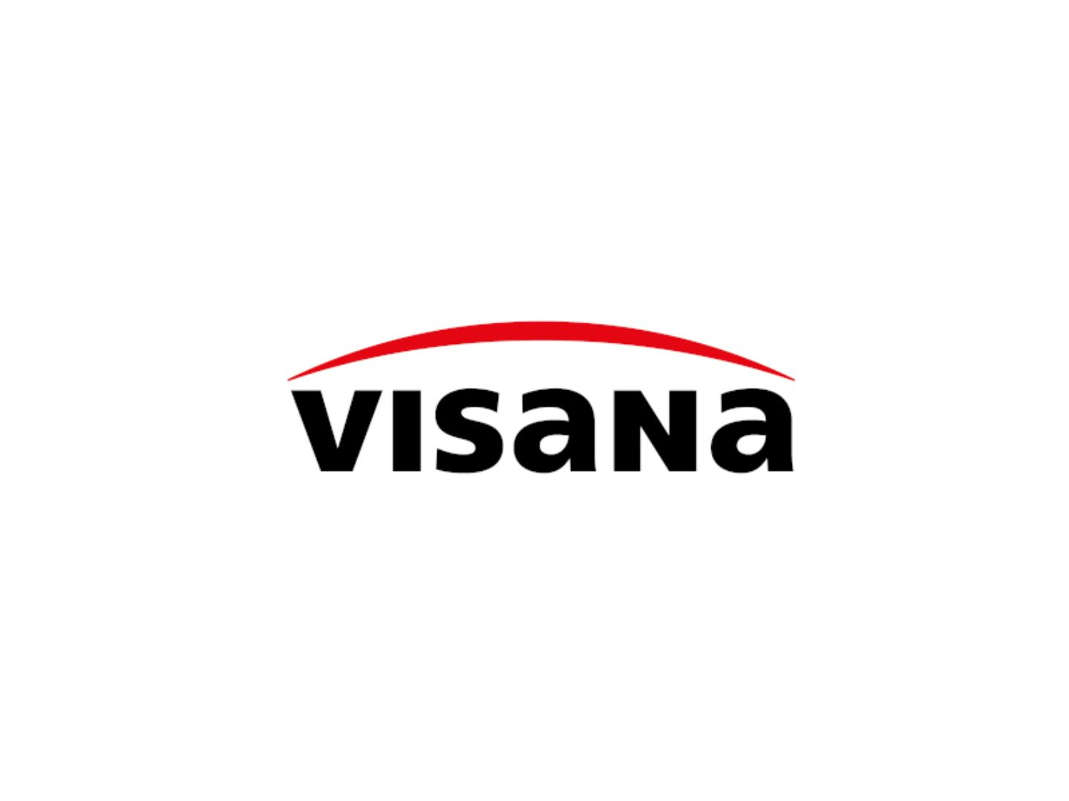
Swiss insurance group Visana
Case Study
Insurance / healthcare
valantic ensures premium improvements in the Sales team’s productivity
  The Visana Group is one of the largest health and accident insurers in Switzerland
  Customer proximity and a human encounter, as equals, is particularly important to Visana
  The Sales team is highly satisfied with the new sales cockpit from MicroStrategy and valantic
  User feedback is extremely positive
  Performance of the cockpits and self-services has improved significantly for all employees
        Visana’s summary: valantic has made a fantastic contribution!
Notes:
https://www.valantic.com/en/case-studies/integrated-sales-cockpit-at-visana-increases-productivity-and-transparency/

Slide 16

Swiss insurance group Visana
Case Study
Insurance / healthcare
Sales managers and employees did not have an overarching cockpit for providing a well arranged, up-to-date overview of all KPIs.
The enterprise analytics platform from MicroStrategy and valantic offers powerful, well arranged, up-to-date dashboards. All relevant data sources were integrated accordingly.
Challenge
Consulting approach & technology
Transparency and productivity have risen significantly in the Sales department. The Sales team is highly satisfied with the new solution, and user feedback is extremely positive.
Benefits for the customer
Productivity
KPI granularity
Satisfaction score
Notes:
https://www.valantic.com/en/case-studies/integrated-sales-cockpit-at-visana-increases-productivity-and-transparency/

Slide 17


Schweizerische Bundesbahnen
Case Study
Transport & Logistics
valantic ensures that SBB’s trains are always the first to arrive
to the second.
  Around 1.32 million people rely on SBB's passenger transportation services each day
  15,000 SBB employees generate annual revenues of approx. CHF 5.5 billion
  SBB's legacy financial planning was based on 20 Excel tables, some containing as many as 150 tabs and 12,000 VBA scripts
  The new system is a flexible, integrated, audit-compliant planning solution from Anaplan
        The result: efficient, real-time planning that shortens the cycle by 1.5 months and enables consolidation at the press of a button
Notes:
https://www.valantic.com/en/case-studies/sbb-corporate-planning-with-anaplan/

Slide 18
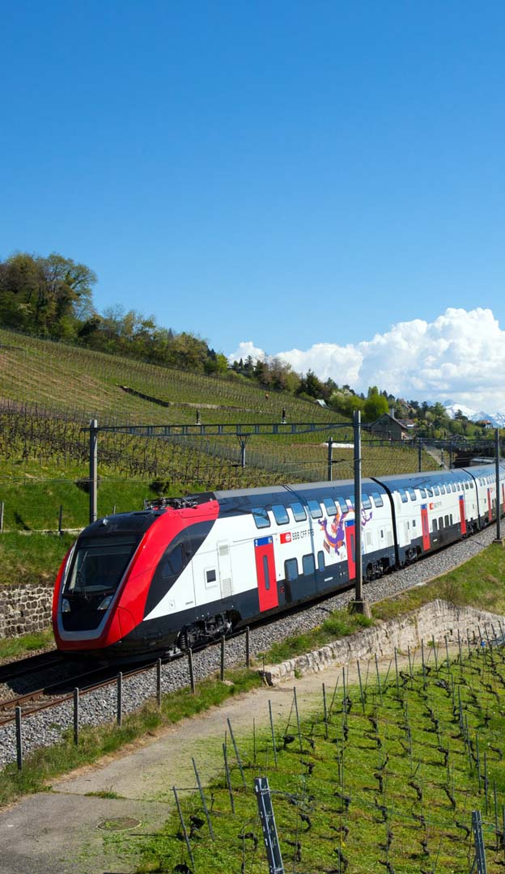
Schweizerische Bundesbahnen
Case Study
Transport & Logistics
The overly complex legacy Excel solution could no longer meet SBB's requirements. Planning processes took far too long, and internal coordination processes were a huge effort.
Efficient, integrated, auditable planning with Anaplan perfectly addresses all of SBB’s challenges.
Challenge
Consulting approach & technology
Shorter, transparent planning processes that also take account of changes – on time and at short notice – wow SBB’s planners. Passengers also applaud the excellent service to.
Benefits for the customer
Time saving
Transparency
Quality of service
Notes:
https://www.valantic.com/en/case-studies/sbb-corporate-planning-with-anaplan/

Slide 19


Luxury lingerie producer Calida
Case Study
Fashion
valantic ensures that for Calida customers it’s quicker to acquire their attire.
  Channel-specific customer needs that have to be satisfied at short-notice place the highest demands on the luxury lingerie brand's omni-channel sales operations
  Integrated, end-to-end planning and analysis processes serve as the success drivers
  Cross-system data models and integrated data marts for cross-national business units raise complex analyses to the next level
        Agile product development and systematic user and customer orientation create a sound basis for even more success
Notes:
https://www.valantic.com/en/case-studies/calida-relies-on-advanced-planning-analytics/

Slide 20

Luxury lingerie producer Calida
Case Study
Fashion
Efficient management of all merchandize and financial flows in e-commerce and across branch outlets that optimally meets the requirements of a complex omni-channel business model.
Uniform data models and key performance indicators, end-to-end planning, self-services based on amongst others IBM Cognos Analytics/TM1 and MS SQL Server Analytics/TM1.
Challenge
Consulting approach & technology
Future-proof technological basis with a high business focus, harmonization of business-oriented KPIs as a strategic success driver.
Benefits for the customer
Efficiency
Analytics
Revenues
Notes:
https://www.valantic.com/en/case-studies/calida-relies-on-advanced-planning-analytics/

Slide 21

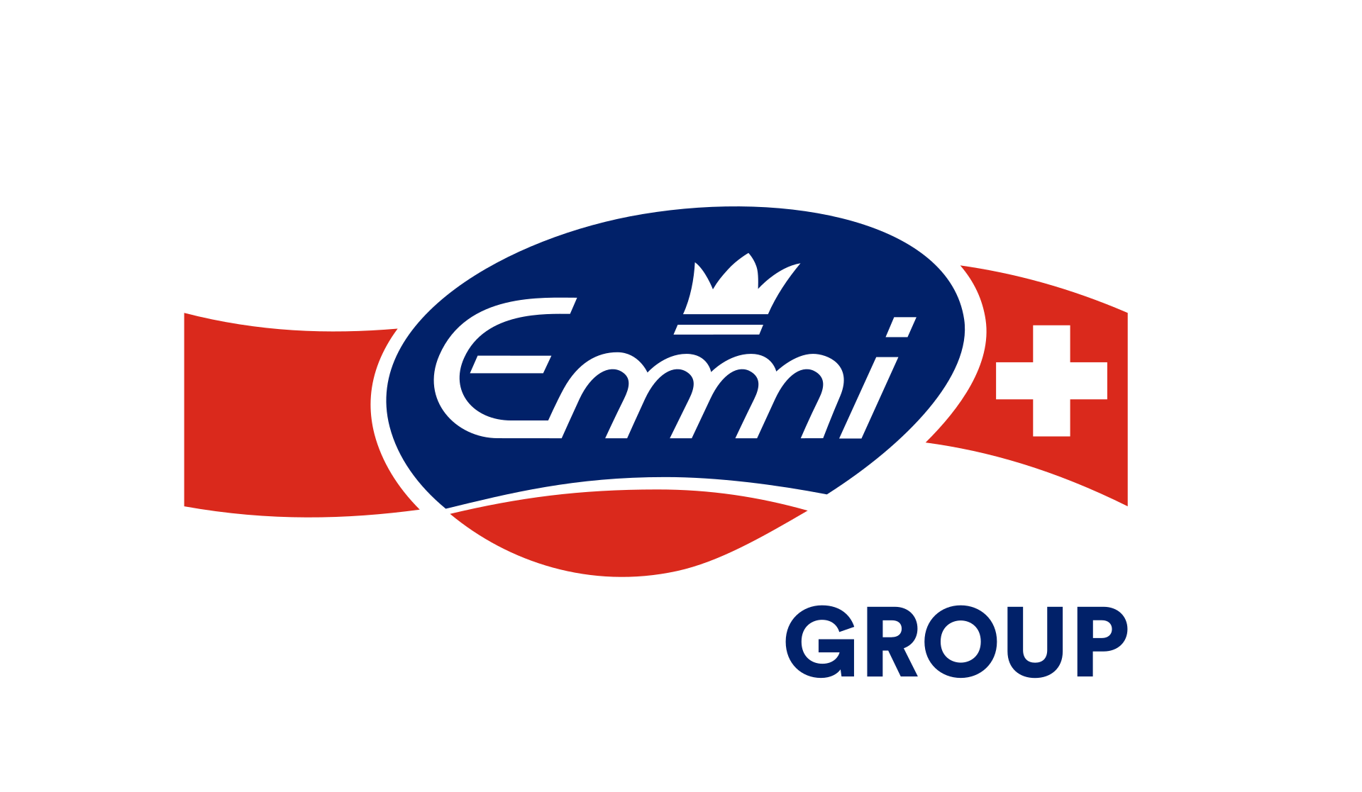
Premium dairy Emmi
Case Study
Groceries / Food
valantic now ensures better sales results at Emmi.
  Fine-grain reporting as the basis for more-successful business decisions
  Ability of specialist divisions to prepare reports and dashboards with greater ease, speed and accuracy
  "Lean BI" greenfield approach with MicroStrategy's advanced analytics
  More powerful DWH architecture and "Lean ERP" Infor M3
        valantic successfully implemented all these requirements, laying the foundation for improved sales and more success.
Notes:
https://www.valantic.com/en/case-studies/powerful-innovation-concept-lean-bi-with-emmi-and-microstrategy/

Slide 22

Premium dairy Emmi
Case Study
Groceries / Food
The legacy data warehouse/BI and old reports no longer fulfilled the specialist divisions’ needs. Relevant reports could not be realized and could not therefore be used for making business decisions.
"Lean BI/Lean ERP" greenfield approach with MicroStrategy and ERP Infor M3 – migration to an innovative, new DWH automation and analytics platform – new sales reports and ship-to-level reports.
Challenge
Consulting approach & technology
Significant time saving – the specialist divisions and sales force now make decisions based on detailed, daily reports, resulting in increased sales and order volumes.
Benefits for the customer
Performance
Analytical Accuracy
Business Benefits
Notes:
https://www.valantic.com/en/case-studies/powerful-innovation-concept-lean-bi-with-emmi-and-microstrategy/

Slide 23

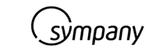
Insurance company Sympany
Case Study
Insurance / healthcare
valantic ensures that Sympany always offers every customer the best possible advice and insurance.
  Highly performant and efficient access to all required data by all departments
  Swift and flexible migration to the new data warehouse and IBM Cognos Analytics, including migration of all data
  Technical and content optimization of reports during ongoing operations – improved rights and access concept
        Improved analyses and advice by the specialist divisions provide for more-satisfied customers.
Notes:
https://www.valantic.com/en/case-studies/sympany-optimizes-ibm-cognos-analytics-for-new-data-warehouse/

Slide 24


Insurance company Sympany
Case Study
Insurance / healthcare
To improve the analytics infrastructure, migrate to a new data warehouse, and adapt and optimize IBM Cognos Analytics.
Swift implementation of, and migration to, the new DWH during ongoing operations to ensure uninterrupted business operations for the specialist divisions at all times.
Challenge
Consulting approach & technology
Easier operation and clearer presentation for all specialist-division employees. The growing need for analytics is served reliably and to the full satisfaction of the users.
Benefits for the customer
Customer Satisfaction
Staff Satisfaction
Customer Benefits
Notes:
https://www.valantic.com/en/case-studies/sympany-optimizes-ibm-cognos-analytics-for-new-data-warehouse/

Slide 25


Evotec AG
Case Study
Life science
valantic ensures that, at Evotec, time-consuming research for corporate data is now a thing of the past.
  The legacy financial planning and reporting system at research-based biotech company Evotec was labor-intensive and error-prone due to its manual data entry processes
  A new system was needed to centrally capture the company's data and expedite the planning process
  Following a workshop, Evotec introduced IBM Cognos TM1 and IBM Cognos Business Intelligence
  Today, data are aggregated centrally and displayed in a browser. Reporting and planning tools access consistent, up-to-date information
        Time-consuming research for corporate data is now a thing of the past.
Notes:
https://www.valantic.com/en/case-studies/evotec-ag-uses-ibm-cognos-technology-for-planning-reporting-and-analysis/

Slide 26

Evotec AG
Case Study
Life science
Research-based biotechnology company Evotec AG relies on accurate planning of business and research projects.
During a workshop, valantic convinced Evotec AG of IBM Cognos TM1 and IBM Cognos Business Intelligence. With these solutions, Evotec is able to plan, analyze and create simulations and forecasts.
Challenge
Consulting approach & technology
Thanks to valantic, Evotec now has quicker, more reliable and more flexible planning, reporting and detailed analytical capabilities at its fingertips.
Benefits for the customer
Faster Analysis
More efficient planning
Improved Forecasting
Notes:
https://www.valantic.com/en/case-studies/evotec-ag-uses-ibm-cognos-technology-for-planning-reporting-and-analysis/

Slide 27


Ministerium Ostbelgien
Case Study
Government/Public Services
valantic ensures that budgetary figures are made transparent, and citizens’ trust is built.
  The Finance-Monitor of Ministerium der Deutschsprachigen Gemeinschaft Ostbelgiens*) ensures maximum transparency
  Parliamentarians and citizens can access up-to-date budgetary figures at any time, from anywhere worldwide
  IBM Cognos Analytics based on a data warehouse was used
        Detailed insights into the ministry's work helps build citizens’ trust.
        *) Ministry of the German-Speaking Community of East Belgium
Notes:
Case Study: https://www.valantic.com/en/case-studies/finance-monitor-provides-maximum-transparency-at-the-ministry-of-the-german-speaking-community-of-belgium/

Slide 28

Ministerium Ostbelgien
Case Study
Government/Public Services
Numerous crises of confidence – such as the financial crisis – have damaged Europe’s culture of trust.
The Finance-Monitor aims to render the budgetary figures transparent for parliamentarians and citizens.
Challenge
Consulting approach & technology
As a cutting-edge political trust-building instrument, the Finance-Monitor is visually appealing and can be operated easily, intuitively and interactively by all.
Benefits for the customer
Notes:
Case Study: https://www.valantic.com/en/case-studies/finance-monitor-provides-maximum-transparency-at-the-ministry-of-the-german-speaking-community-of-belgium/

Slide 29

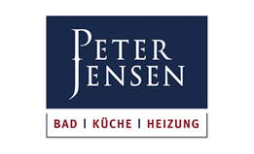
Wholesaler Peter Jensen relies on
IBM Cognos Business Analytics
Case Study
Wholesale
valantic ensures that “All the genteel can pee with more zeal” at Peter Jensen!
  Introduction of a business analytics solution from IBM at the Hamburg-based sanitary wholesaler
  3,500 tradespeople from Sylt to Stralsund benefit from transparent reports and improved
  sales plans
  Information can be linked and evaluated
  across systems
  Around 50 detailed revenue and sales reports allow more precise data evaluation
        In this way: “All the genteel can pee with more zeal”!
Notes:
https://www.valantic.com/en/case-studies/wholesaler-peter-jensen-relies-on-ibm-cognos-business-analytics/

Slide 30
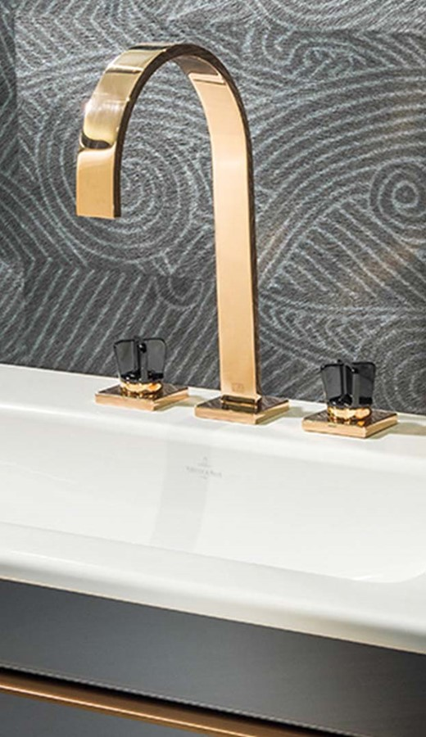
Wholesaler Peter Jensen relies on
IBM Cognos Business Analytics
Case Study
Wholesale
Peter Jensen, was about to introduce a new CRM system but also needed an agile planning and analytics solution that could provide answers quickly and flexibly.
Peter Jensen introduced IBM Cognos Business Analytics. By introducing a database solution in addition to the new CRM system, information can now be linked and evaluated.
Challenge
Consulting approach & technology
With the Cognos database, the family-owned company links its CRM system with its merchandize management system and generates around 50 detailed sales and revenue reports.
Benefits for the customer
Notes:
https://www.valantic.com/en/case-studies/wholesaler-peter-jensen-relies-on-ibm-cognos-business-analytics/

Slide 31


AOK Niedersachsen – looks after more than 27 million insured people
Case Study
INSURANCE
valantic ensures that the business intelligence is spot-on at AOK Niedersachsen.
  As part of an ambitious BI project, AOK Lower Saxony built up an extensive database incorporating all its business processes and specialist divisions
  At the same time, AOK implemented a BI system based on IBM Cognos for all its management and controlling processes, including planning, reporting, analytics and forecasting
  valantic supported AOK in the development and installation of the complex BI system
  Today, around 750 employees have access to graphical dashboards and analyses – in some cases en route using mobile devices
        In this way, AOK always has up-to-date information for effective process control
Notes:
Case Study: https://www.valantic.com/en/case-studies/aok-niedersachsen-significantly-improves-policyholder-service-with-ibm-cognos/

Slide 32

AOK Niedersachsen – looks after more than 27 million insured people
Case Study
INSURANCE
AOK needed a uniform database covering all its business processes in order to ensure the efficiency of its corporate management. 11,000 data fields, over 500 tables and more than 3.5 billion data records are processed.
Assisted by IBM Cognos, around 750 users – from the board of directors to clerks – access relevant key performance indicators via graphical dashboards.
Challenge
Consulting approach & technology
AOK benefits from informed decision making thanks to easy access to analyses and dashboards, excellent user acceptance thanks to a significant speed increase and lower costs through streamlined storage.
Benefits for the customer
Quick Decision Making
Increased Speed
Less Storage
Notes:
Case Study: https://www.valantic.com/en/case-studies/aok-niedersachsen-significantly-improves-policyholder-service-with-ibm-cognos/

Slide 33
SAP Services
References

Slide 34


Gira Strengthens Its Long-Term Viability Through Digitalization
Case Study
BUILDING CONTROL
valantic ensures that at Gira they’re now driving their own internal digital transformation
successfully
as well
        Gira enjoyed a digitalization turbo boost based on
        an Extended Brownfield Conversion to SAP S/4HANA and reporting in the SAP Analytics Cloud.
  Gira, based in Radevormwald near Düsseldorf, is a leading maker of electrotechnical and networked building control systems and is among the smart building pioneers.
  The company, which uses SAP, was due to migrate to SAP S/4HANA and was also looking for a new reporting tool for its daily reporting.
  Gira decided on a SAP S/4HANA migration based on valantic’s Extended Brownfield Conversion methodology and the development of a new reporting system using the SAP Analytics Cloud (SAC).
  A high-speed valantic SAP S/4HANA Extended Brownfield Conversion established the basis for digital transformation and boosted process efficiency; SAP BW on HANA and SAC have provided for better reporting transparency and performance.
Notes:
https://www.valantic.com/en/case-studies/s4hana-and-sap-sac-at-gira/

Slide 35
Gira Strengthens Its Long-Term Viability
Through Digitalization
Case Study
BUILDING CONTROL
To swiftly migrate Gira to SAP S/4HANA and replace its legacy in-house-developed daily reporting system with a SAP Analytics Cloud solution.
valantic Extended Brownfield Conversion to SAP S/4HANA, and the development of a new daily reporting system based on the legacy SAP BW on HANA and the SAP Analytics Cloud.
Challenge
Consulting approach & technology
Fast and successful migration to S/4HANA as the basis for Gira’s long-term viability and digitalization; enhanced overview, transparency and efficiency made possible by a daily updated management dashboard.
Benefits for the customer
Long-term viability
Efficiency
Transparency
Notes:
https://www.valantic.com/en/case-studies/s4hana-and-sap-sac-at-gira/

Slide 36

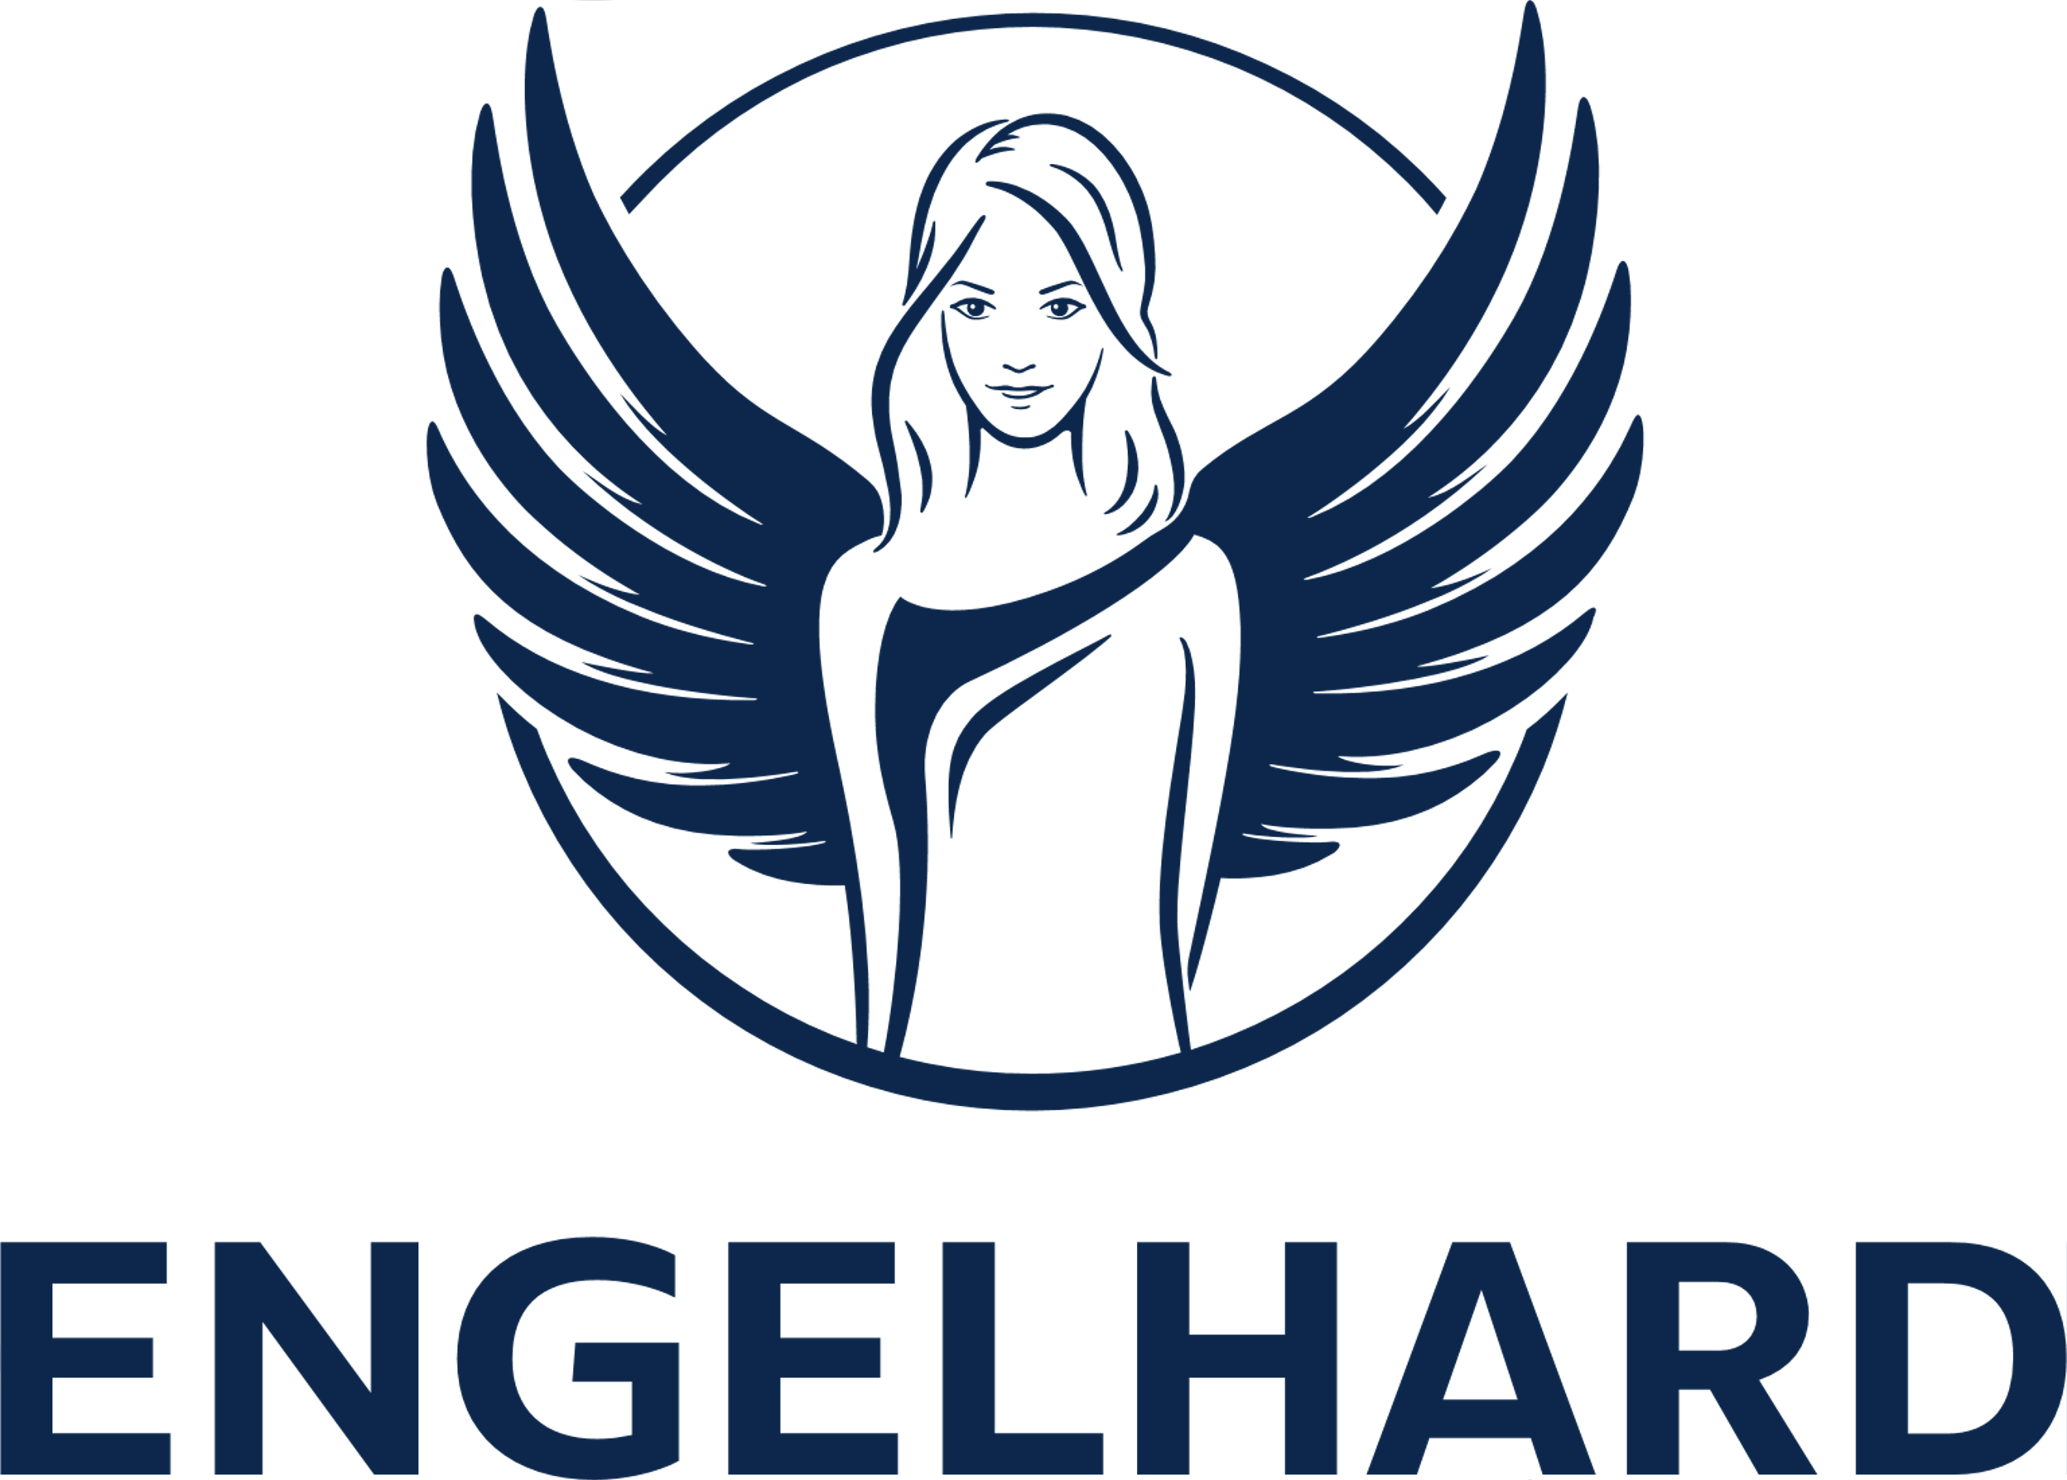
Engelhard Turns to Contract Management Software
Case Study
PharmaCEUTICALS
valantic has just the right remedy for Engelhard Arzneimittel’s contract management
  Engelhard Arzneimittel is a leading supplier of over-the-counter medications, including the Prospan® and isla® brands.
  It was looking for a digital contract management system that ensures audit-proof management of its contractual documents, as well as providing improved transparency.
  The SAP add-on cuContract enables cross-divisional record management; at the same time, clear access control policies protect the company’s sensitive data.
        valantic’s contract management system gives Engelhard Arzneimittel a clear overview of all its contractual deadlines.
Notes:
https://www.valantic.com/en/case-studies/engelhard-contract-management//

Slide 37
Engelhard Turns to Contract Management Software
Case Study
PharmaCEUTICALS
To implement a contract management system that ensures adherence to deadlines, centralized and audit-proof data storage, and transparency across all contracts and records.
Detailed identification of Engelhard Arzneimittel’s needs, implementation of valantic's cuContract add-on (which is seamlessly integrated into SAP), and project-accompanying process optimization.
Challenge
Consulting approach & technology
Digital record management, a clear overview of all contracts, dates/deadlines, and process efficiency thanks to comprehensive workflows.
Benefits for the customer
Meeting of deadlines
Audit-proof processes
Transparency
Notes:
https://www.valantic.com/en/case-studies/engelhard-contract-management/

Slide 38

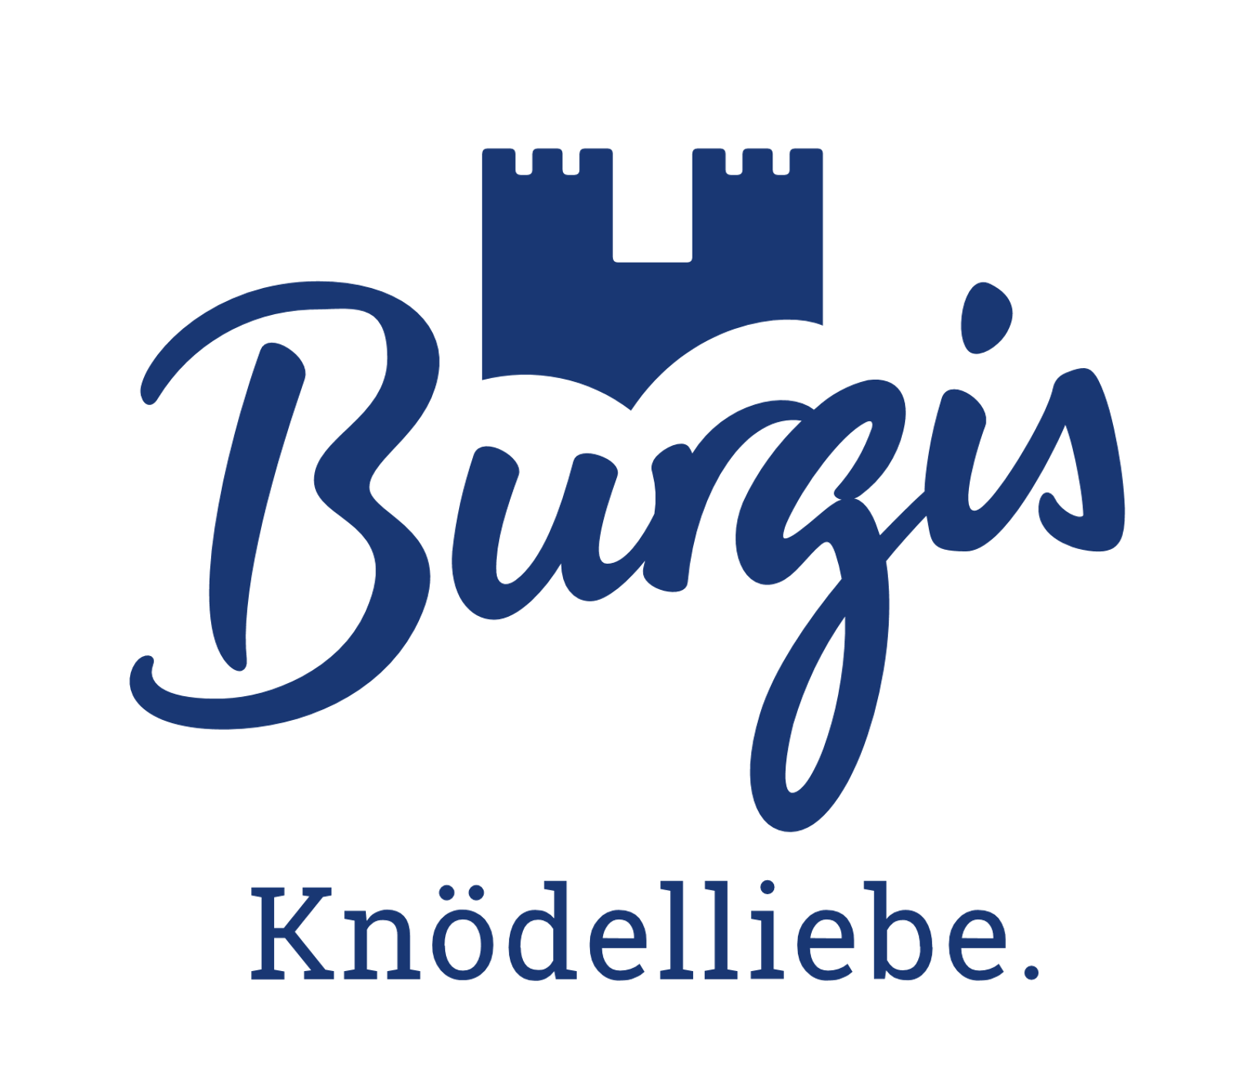
Burgis – Flexible Reporting Improves the Efficiency of the Sales Department
Case Study
FOOD INDUSTRY
valantic ensures that at Burgis their sales data are appetizing also
        The dumpling manufacturer Burgis is optimizing the efficiency of its sales department with comprehensive revenue reporting in the SAP Analytics Cloud.
  Burgis, a local family-run business from Neumarkt near Nuremberg, makes dumpling products from regionally sourced ingredients that are intended to give customers that “Sunday feast experience”.
  An intuitive and flexible revenue reporting system aims to provide the sales department with all relevant KPIs and thereby enhance its overall efficiency.
  valantic’s analytics team needed just a few weeks to implement the SAP Analytics Cloud with custom retail KPIs and an extended data model.
  Improved analytical flexibility, enhanced reporting automation, and intuitive operating save time and result in more nuanced KPIs.
Notes:
https://www.valantic.com/en/case-studies/comprehensive-revenue-reporting-in-the-sap-analytics-cloud/

Slide 39
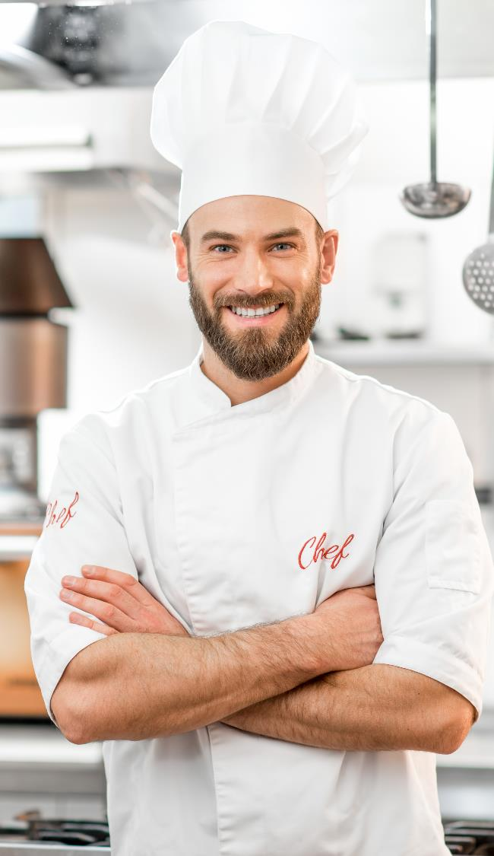
Burgis – Flexible Reporting Improves the Efficiency of the Sales Department
Case Study
FOOD INDUSTRY
To improve the efficiency of the sales depart-ment by providing all relevant management KPIs from SAP S/4HANA, and to use these to generate reports based on intuitive workflows and clearly arranged information.
Implementation of the SAP Analytics Cloud as per Burgis’s needs; extension of the S/4HANA data model; introduction of custom retail KPIs; user coaching.
Challenge
Consulting approach & technology
Fine-grained analyses, greater flexibility, faster workflows through automation, intuitive user interface, straightforward connection to SAP S/4HANA, and low maintenance overheads.
Benefits for the customer
Performance
Analytical flexibility
Degree of automation
Notes:
https://www.valantic.com/en/case-studies/comprehensive-revenue-reporting-in-the-sap-analytics-cloud/

Slide 40

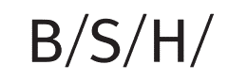
BSH Hausgeräte GmbH
Case Study
Manufacturing – Household appliances
valantic ensures the appliance of paperless, digital contracts and signatures at BSH.
  With 62,000 employees, BSH is a leading company in the household appliances sector
  Introduction of the SAP-integrated contract management solution cuContract
  Enterprise-wide digitalization of sales agreements in more than 10 countries
  Replacement of legacy Excel and SharePoint solutions with electronic workflows supporting digital signatures – audit-proof archiving of all digital documents
        Thanks to valantic, BSH has come one step closer to its dream of a paperless office!

Slide 41

BSH Hausgeräte GmbH
Case Study
Manufacturing – Household appliances
A high volume of paper-based files made it necessary to digitalize the company’s processes. The aim was to standardize and speed up the processes and eliminate sources of error.
By using valantic’s SAP-integrated contract management system, cuContract, sales agreements were digitalized in more than ten countries, and processes were standardized.
Challenge
Consulting approach & technology
Existing Excel and SharePoint solutions were replaced by digital contract management. Protracted approval processes were eliminated, all associated documentation are now managed in an audit-proof manner.
Benefits for the customer
Process Speed
Standardizations
Auditing acceptability

Slide 42

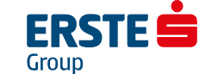
Erste Group Bank AG
Case Study
Banks & financial services
valantic ensures efficiency payoffs for Erste Group Bank’s paperless HR processes.
  With 16 million customers and more than 2,500 branches in seven countries, Erste Group Bank AG is one of the largest banking groups in Central and Eastern Europe. It is part of the Austrian Savings Bank Group (Österreichischer Sparkassenverband).
  Employees of the group should be able to access their HR documents from their workstations and HR processes are to be digitalized as a whole
  valantic’s cuSmarText HR document management system enables use from within SAP, as well as international customizing
        With valantic, HR processes pay off for efficiency at Erste Group Bank.

Slide 43
Erste Group Bank AG
Case Study
Banks & financial services
Digitalization in the HR department based on electronic personnel records that can be used together with SAP HXM and SAP SuccessFactors Employee Central and be customized for country-specific requirements.
valantic’s SAP HXM-based solution, cuSmarText HR, for digital document management.
Challenge
Consulting approach & technology
Efficiency improvements, paperless HR processes of the international locations, ability of employees to access their documents directly from the workplace.
Benefits for the customer
Enhanced workflow efficiency
State-of-the-art HR processes
International usage

Slide 44

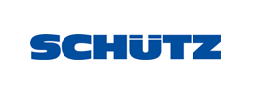
SCHÜTZ
Case Study
Plastic & metal processing
valantic
ensures
SCHÜTZ will successfully wrap up its growth strategy.
  The globally expanding SCHÜTZ Group is a leading manufacturer of high-quality transport packaging, headquartered in Selters, Germany
  The company uses a globally uniform SAP system and is planning a SAP/4HANA migration
  International harmonization of the financial and controlling systems would reduce the complexity of the switchover
  Successful introduction of the new general ledger and asset accounting as well as the merging of cost centers at all locations
        Thanks to valantic and SNP, SCHÜTZ is now fit for migration and further growth
Notes:
https://www.valantic.com/en/case-studies/schuetz-sets-the-course-for-its-sap-s4hana-migration/

Slide 45
SCHÜTZ
Case Study
Plastic & metal processing
Harmonization of the financial and controlling systems at the international locations in preparation of the SAP S/4HANA migration.
Linear approach in accordance with the waterfall model, central project management, data migration in accordance with the SNP Bluefield approach.
Challenge
Consulting approach & technology
Efficiency improvements in finance and controlling; ideally positioned for SAP S/4HANA, continuous optimization and further growth.
Benefits for the customer
SAP S/4HANA readiness
Process efficiency
Company growth
Notes:
https://www.valantic.com/en/case-studies/schuetz-sets-the-course-for-its-sap-s4hana-migration/

Slide 46


Medizinischer Dienst
Berlin-Brandenburg
Case Study
Healthcare
valantic ensures
best-possible medical treatment is provided to
the statutorily insured.
  Medizinischer Dienst Berlin-Brandenburg (MD BB) provides independent expert assessments of medical preventive, rehabilitation and care measures, among other things
  Its aim is to ensure the provision of fair, high-quality medical treatment for the statutorily insured in Berlin and Brandenburg
  A “silent” migration to SAP S/4HANA has positioned MD BB for the future
  valantic’s new hosting provider meets the highest security standards
        Summary of MD BB: Outstanding technical support from valantic.
Notes:
https://www.valantic.com/en/case-studies/sap-migration-s4hana-and-provider-change-at-md-bb/

Slide 47

Medizinischer Dienst Berlin-Brandenburg
Case Study
Healthcare
Flexibility and data security, including the security of highly sensitive policyholder data, could not be adequately assured.
(1) Migration to SAP’s future-proof solution platform S/4HANA
(2) Switch to a valantic-accredited hosting provider with a single-tenancy system guaranteeing maximum possible security.
Challenge
Consulting approach & technology
“Silent” migration to SAP S/4HANA, highest security standards, process optimizations and functional enhancements were implemented to MD BB’s unconditional satisfaction.
Benefits for the customer
S/4HANA migration
Data security
Performance
Notes:
https://www.valantic.com/en/case-studies/sap-migration-s4hana-and-provider-change-at-md-bb/

Slide 48
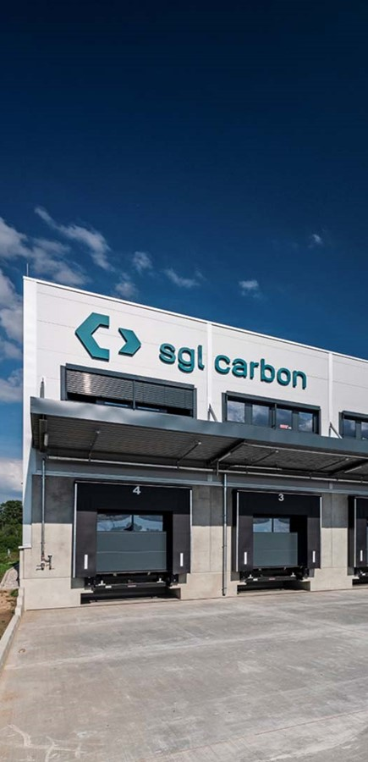
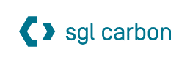
SGL Carbon – Operating globally
Case Study
Chemicals
valantic ensures: With material data at hand, business will flourish!
  SGL Carbon is a global leader in the production of specialty graphites and composites for future-oriented industries
  This requires a complex and wide-ranging material portfolio
  The goal of the project was to harmonize the material master data worldwide and to control it automatically from within the processes
  valantic’s SAP add-on, Master Data Cockpit, does the job perfectly
        Significant efficiency, time and cost gains improve SGL Carbon’s success worldwide.
Notes:
https://www.valantic.com/en/case-studies/sgl-carbon-harmonizes-sap-master-data-management-with-mdc-master-data-cockpit/

Slide 49

SGL Carbon – Operating globally
Case Study
Chemicals
The globally harmonized manufacture of materials controlled from automatisms embedded within the processes.
An optimized, bespoke SAP master data management system using the SAP add-on MCD Master Data Cockpit from the multiple award-winning SAP Gold Partner valantic.
Challenge
Consulting approach & technology
Significant efficiency, time and cost gains improve SGL Carbon’s overall cost position in the global markets.
Benefits for the customer
Efficiency
Time saving
Cost benefits
Notes:
https://www.valantic.com/en/case-studies/sgl-carbon-harmonizes-sap-master-data-management-with-mdc-master-data-cockpit

Slide 50
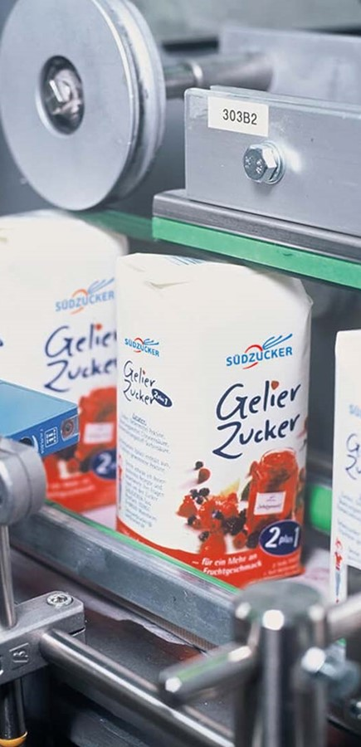

Südzucker Group
Case Study
Food industry
valantic ensures that master data maintenance is sweetened for Südzucker employees.
  Europe's largest sugar producer, Südzucker, processes 4.5 million metric tons of sugar beet every year and operates more than 100 production sites worldwide
  Südzucker was looking for a solution that would allow uniform, end-to-end master data management at all ten companies
  SAP MDC Master Data Cockpit fulfilled all the requirements and enthused the users​
        The transparency that valantic's MDC provides over all companies simplifies work enormously for all involved.
Notes:
Case Study: https://www.valantic.com/en/case-studies/automated-sap-master-data-maintenance-for-suedzucker/

Slide 51
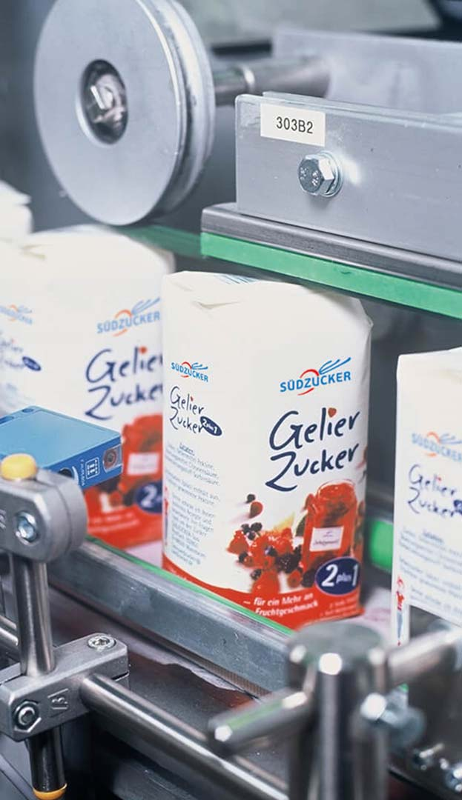
Südzucker Group
Case Study
Food industry
Improvements in the quality and up-to-datedness of the master data were needed to speed up vital cross-company processes and reduce errors – at all 10 businesses.
SAP’s master data management was unable to fulfill all the requirements. The choice fell on SAP Gold partner valantic’s MDC Master Data Cockpit which is fully integrated into SAP.
Challenge
Consulting approach & technology
The specialist divisions’ workloads for managing master data and the processing times have been reduced significantly. Users are very enthusiastic about valantic’s MDC.
Benefits for the customer
Transparency
Processing speed
Error quota
Notes:
https://www.valantic.com/en/case-studies/automated-sap-master-data-maintenance-for-suedzucker/

Slide 52


Cheese producer Hochland
Case Study
Groceries / Food
valantic ensures that Hochland successfully masters its digital transformation with SAP S/4HANA.
  SAP is discontinuing its support for the legacy SAP R/3 system. Hochland had to act to avoid a competitive disadvantages in the future.
  Hochland and valantic decided on a greenfield approach with a sprinkling of brownfield elements – flexibly and pragmatically
  Hochland and valantic used agile project methodologies to achieve outstanding results
        Hochland is safely positioned for future success with S/4HANA. The migration project is scheduled for completion by 2024.
Notes:
https://www.valantic.com/en/case-studies/hochland-migrates-to-sap-s4hana/

Slide 53

Cheese producer Hochland
Case Study
Groceries / Food
To migrate a 20-year-old SAP R/3 system with a large number of in-house developments to the new SAP S/4HANA system.
Hochland and valantic opted for a flexible, pragmatic greenfield approach. An agile project methodology dovetails the process planning and realization by means of 1-month sprints, thereby quickly achieving high-quality results.
Challenge
Consulting approach & technology
S/4HANA will serve as the foundation for a successful, digital transformation and is an essential component of the S/4 Future project which also incorporates IBP, HCM, MES, Big Data Analytics and employee training.
Benefits for the customer
Future security
Competitive strength
Agility
Notes:
https://www.valantic.com/en/case-studies/hochland-migrates-to-sap-s4hana/

Slide 54

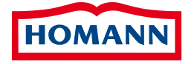
HOMANN Feinkost
Case Study
Groceries / Food
valantic ensures that, at Homann, not only the ingredients, but also the systems, harmonize perfectly with one another.
  Homann Feinkost is a subsidiary of the Theo Müller group (TMG) of companies.
  To ensure its long-term viability, UTG is continuously consolidating its core processes and IT landscape as the company continues to grow
  Integration of Homann's SAP environment with numerous subsystems into UTG's SAP landscape for an integrated system and data basis
        The harmonized SAP landscape creates a sound foundation for future optimizations and process harmonizations.
Notes:
https://www.valantic.com/en/case-studies/sap-harmonization-homann-feinkost/

Slide 55
HOMANN Feinkost
Case Study
Groceries / Food
Creation of an integrated SAP environment with a uniform data basis for Homann’s six German locations, connection of numerous subsystems, harmonization of all core areas, data migration and test management.
Early preparation of the data migration, industry and technology expertise, and systematic risk management for a smooth go-live without disrupting business operations.
Challenge
Consulting approach & technology
Future-proof system basis established for later process optimization within the Group. The milestone project was realized on time and within budget.
Benefits for the customer
System harmonization
Process optimization
Long-term viability
Notes:
https://www.valantic.com/en/case-studies/sap-harmonization-homann-feinkost/

Slide 56


Lorenz Bahlsen Snack-World
Case Study
Groceries / Food
In our structure, responsibilities and individual work-step sequences within a workflow are always changing. The Master Data Cockpit now allows us to design the workflows flexibly and adapt them to our needs.
Mario Kernjak, Project Management,
Lorenz Snack-World
  Introduction of a new solution for managing SAP master data: The choice fell on valantic's SAP add-on "Master Data Cockpit" (MDC)
  The processes for setting up articles in SAP are simplified and expedited and a high level of data quality is permanently ensured
  Unambiguous assignment of responsibilities for the various field definitions and a verifiable dual control principle for the article master data and environment data
        The consistently high quality of SAP master data ensures that the snacks stay savory at Lorenz.
Notes:
https://www.valantic.com/en/case-studies/lorenz-optimizes-material-creation-processes-in-sap-with-master-data-cockpit-from-valantic/

Slide 57

Lorenz Bahlsen Snack-World
Case Study
Groceries / Food
A new solution for managing the SAP master data was needed to simplify and expedite the article setup process in SAP and ensure a continuous high level of data quality based on the principle of dual control.
A solution fully integrated into SAP: valantic’s “Master Data Cockpit”. The automated setup of master data for materials, debtors and creditors greatly reduces maintenance overheads and helps avoid data-entry errors.
Challenge
Consulting approach & technology
New material can be set up with predefined values in a single step. Individual workflows can be defined for each material type. In addition, it is now possible to set deadlines and check current status of individual work steps.
Benefits for the customer
Reduction of lead times
Reduction of total workflow duration
Reduction of manual input errors
Notes:
https://www.valantic.com/en/case-studies/lorenz-optimizes-material-creation-processes-in-sap-with-master-data-cockpit-from-valantic/

Slide 58

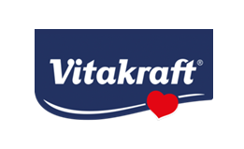
VITAKRAFT
Case Study
Pet food
valantic ensures that at Vitakraft the cat knows what’s in the bowl.
  Global authorization management for 420 SAP users
  Simple role maintenance, control and documentation of critical authorizations
  Introduction of valantic's apm atlantis software
  Bulk changes at the push of a button
        apm atlantis offers a very high degree of role maintenance automation. Even small teams are able to handle all daily requests with ease.
Notes:
https://www.valantic.com/en/case-studies/sap-authorization-management-for-vitakraft/

Slide 59

VITAKRAFT
Case Study
Pet food
Convenient assignment and management of access rights, low training overheads, automatic checking of critical transactions.
A uniform and automated transnational authorization management system integrated into SAP.
Challenge
Consulting approach & technology
An integrated solution that is guaranteed to be legally compliant and that significantly reduces the daily administration overheads for role maintenance.
Benefits for the customer
Notes:
https://www.valantic.com/en/case-studies/sap-authorization-management-for-vitakraft/

Slide 60
Notes on SAP references
        Further slides relating to SAP references will also be available in the following sections in future:
  Supply Chain Excellence Division (e.g. SAP EWM, SAP, IBP, SAP TM etc.)
  Digital Strategy & Analytics Division (including SAP SAC)
  Customer Experience Division (including SAP Commerce Cloud, SAP Sales Cloud etc.)

Slide 61
Smart Industries
References

Slide 62

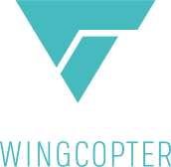
Wingcopter – Flight Logistics at Its Best
Case Study
AEROSPACE
valantic
ensures that Wingcopter’s delivery drones get off to a flying start
        valantic’s Product Lifecycle Management (PLM) solution help Wingcopter’s planning and production efficiency to soar.
  Wingcopter is a German maker of delivery drones capable of vertical take off and landing (VTOL).
  Delivery drones must comply with the applicable local authorities’ regulations. Sharp fluctuations in planning and production were impairing efficiency.
  A strategic PLM solution was needed to manage the various components and configurations efficiently and transparently.
  valantic’s integrated solution consisting of four key components optimized the planning and production processes – giving Wingcopter a real competitive edge.
Notes:
https://www.valantic.com/en/case-studies/wingcopter-flying-logistics-at-its-best/

Slide 63
Wingcopter – Flight Logistics at Its Best
Case Study
AEROSPACE
Sharp fluctuations in Wingcopter’s planning and production processes, excessive data duplication, ad a lack of approval processes and a standardized product structure.
valantic’s PLM specialists worked with the stakeholders to analyze the company’s processes, infrastructure and business requirements and develop an integrated solution.
Challenge
Consulting approach & technology
valantic’s PLM solution consisting of four key components provides for more transparency, flexibility and reliability. Efficiency has risen and costs have fallen.
Benefits fo the customer
Transparency
Profitability
Customer satisfaction
Notes:
https://www.valantic.com/en/case-studies/wingcopter-flying-logistics-at-its-best/

Slide 64
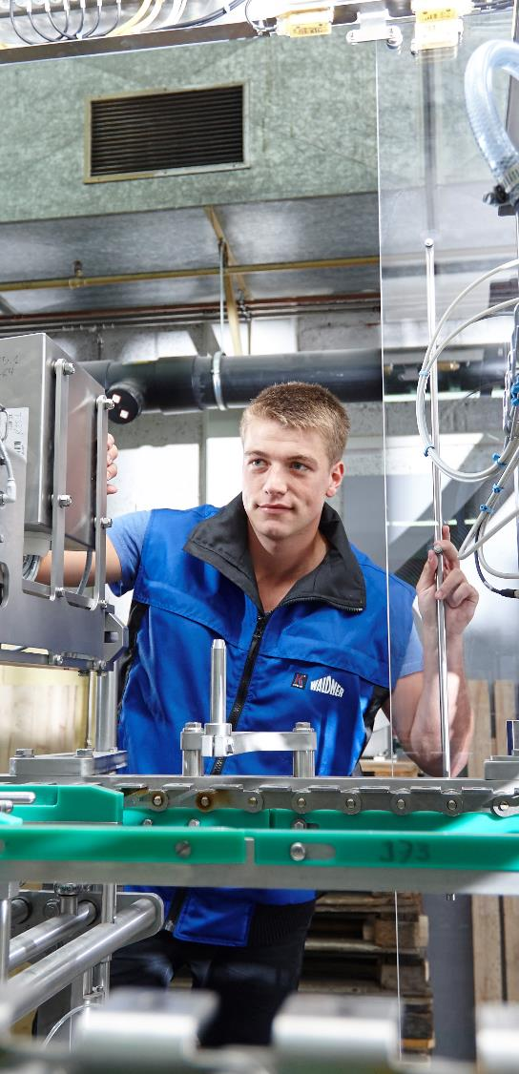

Project and Production Planning Integrated at Hermann Waldner
Case Study
MECHANICAL & PLANT ENGINEERING
“We have achieved a high level of planning transparency and process stability.“
Dr.-Ing. Christian Küber, Head of Technical Applications at WALDNER
  Herrmann Waldner is a specialist manufacturer of fully automatic filling and sealing machines and packaging systems and employs around 1,600 staff worldwide.
  As part of the introduction of SAP S/4HANA, the company wanted to optimize and redefine the planning processes.
  In the course of the project, valantic’s wayRTS APS software, which was already in use, was upgraded to include the wayPRO component.
        Perfect interplay: Data sovereignty now lies with SAP at Waldner, while scheduling sovereignty lies with valantic’s waySuite.
Notes:
https://www.valantic.com/en/case-studies/production-and-project-planning-at-waldner/

Slide 65
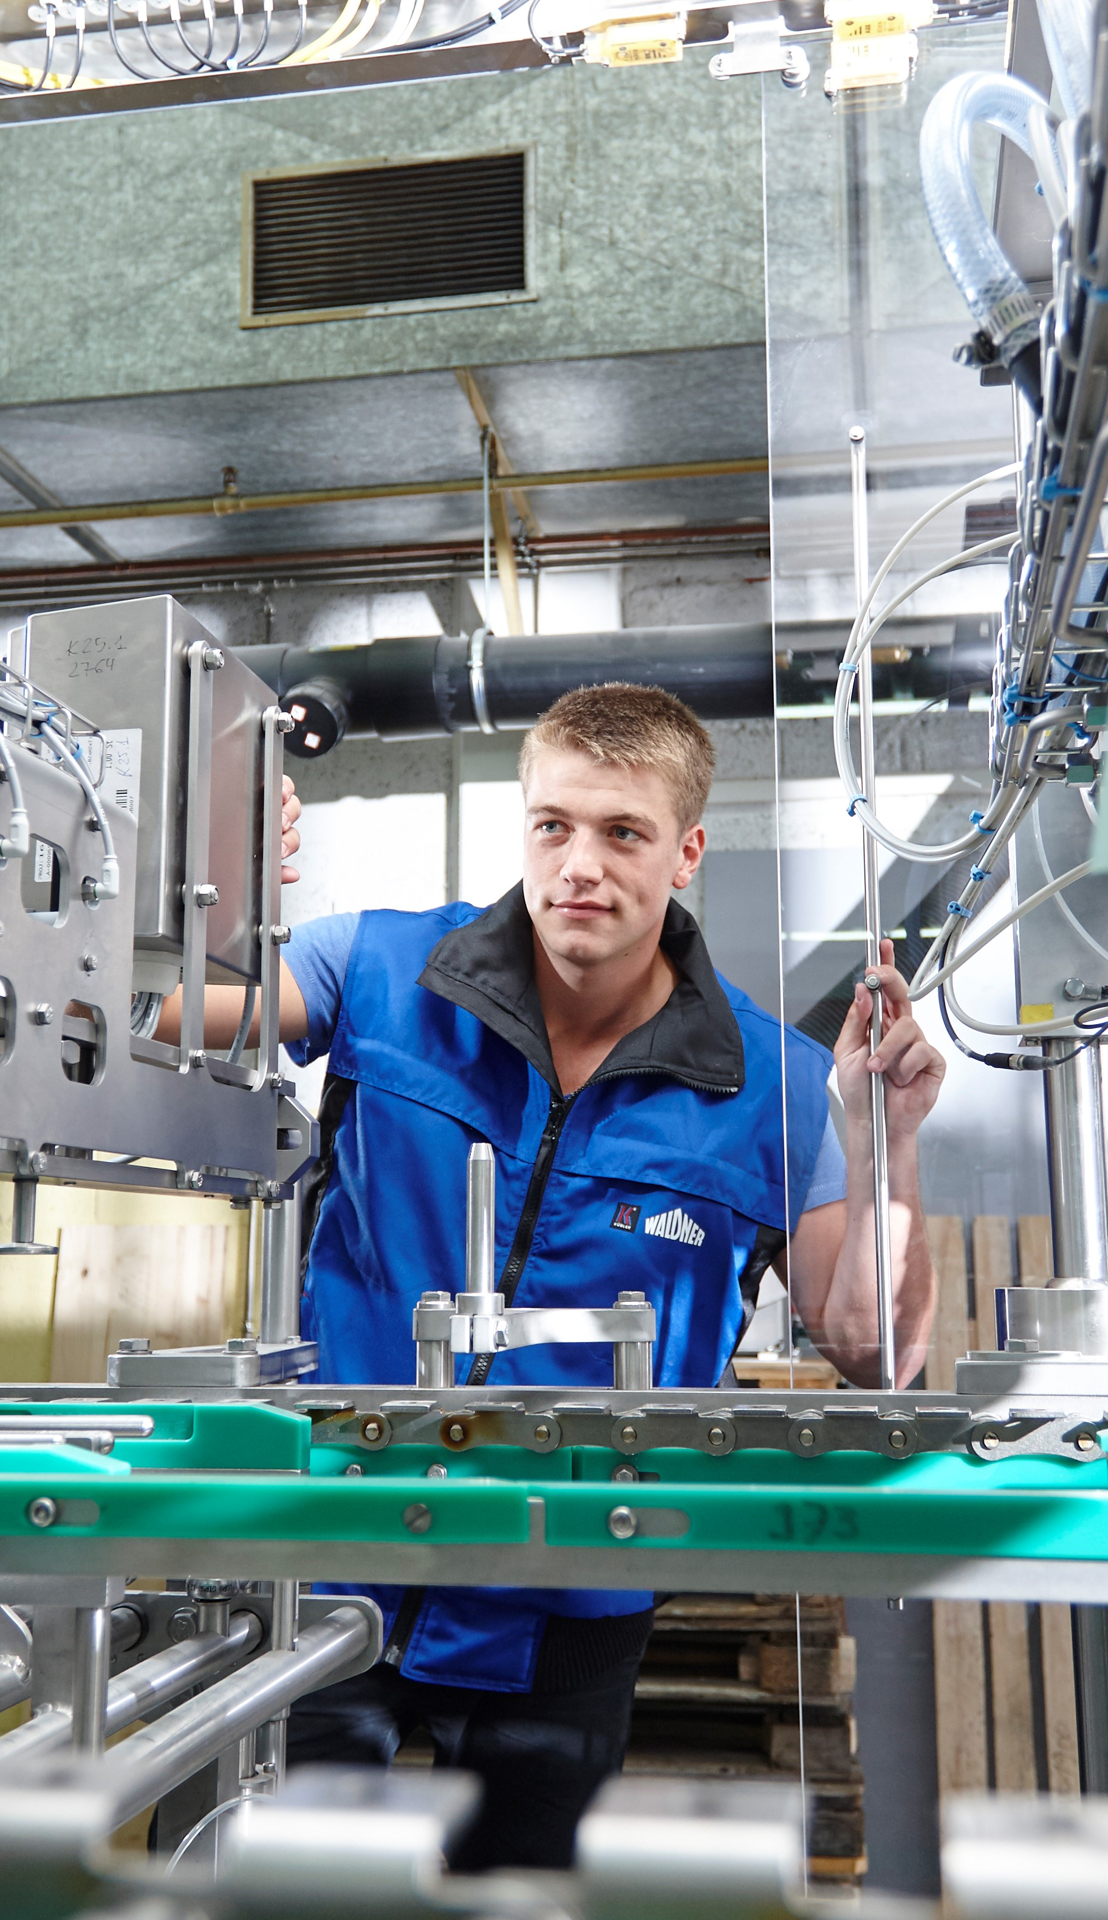
Project and Production Planning Integrated at Hermann Waldner
Case Study
MECHANICAL & PLANT ENGINEERING
To provide for transparency despite highly complex project planning, and to optimize the planning processes as part of the SAP S/4 HANA implementation.
SAP S/4HANA is used as the master data management system, supplemented by Advanced Planning & Scheduling in valantic’s wayRTS.
Challenge
Consulting approach & technology
Transparent planning and visualization of complex relationships, as well as the efficient distribution of tasks between the ERP and APS systems.
Benefits for the customer
Planning transparency
Process stability
Planning dependability
Notes:
https://www.valantic.com/en/case-studies/production-and-project-planning-at-waldner/

Slide 66


Tecan – Digital Twins Improve
Lab Processes
Case Study
LIFE SCIENCE
IoT platform from valantic takes operating data under the microscope
        Cloud-based IoT platform improves efficiency and productivity by interconnecting laboratory equipment and analyzing operating data.
  Tecan is an international manufacturer of laboratory equipment and a market leader for laboratory automation in the life sciences domain.
  valantic developed the IoT platform IntrospectTM for Tecan which allows laboratory operators to analyze the operating data of all their laboratories and robots as digital twins.
  The platform was developed after a three-week proof of concept, optimized on the basis of customer feedback, and achieved market maturity in just nine months.
  Today, Tecan customers benefit from improved transparency and optimization of their laboratory processes.
  Tecan has since seen strong customer demand for IntrospectTM. The platform also offers enormous potential for further optimization and service offerings.
Notes:
https://www.valantic.com/de/referenzen/mehr-effizienz-und-produktivitaet-bei-tecan/

Slide 67
Tecan – Digital Twins Improve Lab Processes
Case Study
LIFE SCIENCE
To quickly develop an IoT platform for interconnecting laboratory equipment, despite rigorous safety and documentation requirements.
Agile development methodology with a three-week proof of concept, optimization on the basis of customer feedback, development of a market-ready platform based on ThingWorx in nine months.
Challenge
Consulting approach & technology
The solution enables laboratory equipment to be interconnected across multiple locations and provides comprehensive information and analyses on their status, utilization and consumption.
Benefits for the customer
Transparency
Process optimization
Customer demand
Notes:
https://www.valantic.com/de/referenzen/mehr-effizienz-und-produktivitaet-bei-tecan/

Slide 68
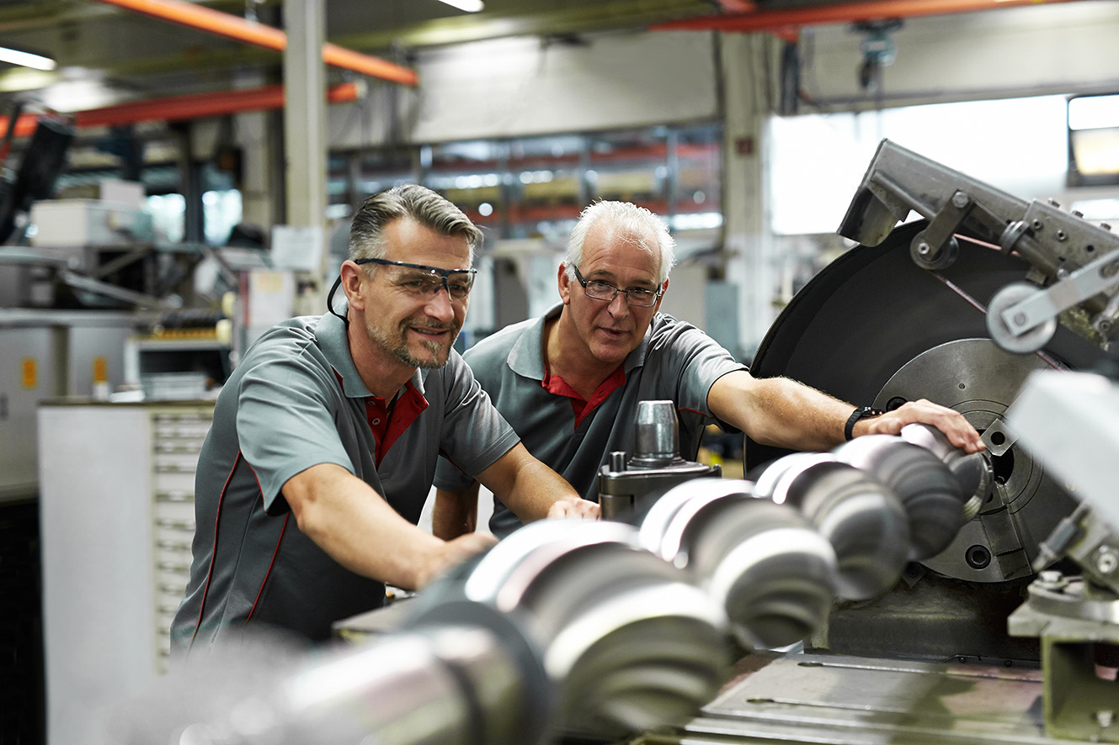

SCM Processes Optimized at Pump Producer SEEPEX
Case Study
MECHANICAL ENGINEERING
valantic ensures that everything goes with the flow at SEEPEX
  SEEPEX is a leading specialist for pump technology and employs more than 800 staff in 70 countries.
  The introduction of valantic’s Advanced Planning & Scheduling Software wayRTS has helped SEEPEX to reinvent its planning organization, almost double the delivery reliability of its Bottrop plant, and optimize its global supply chains.
  The company is now positioned to realistically plan customer orders, visualize bottlenecks in collective orders, and simulate potential solutions.
        Thanks to valantic, SEEPEX’s production planning is now ticking over smoothly.
Notes:
https://www.valantic.com/en/case-studies/valantic-optimizes-scm-at-seepex/

Slide 69
SCM Processes Optimized at Pump Producer SEEPEX
Case Study
MECHANICAL ENGINEERING
Poor transparency of critical deadlines was causing problems in terms of reliable deliv-eries. Complex planning & scheduling were hindering effective capacity planning. Global demand planning was also inadequate.
valantic helped optimize the supply chain processes and introduce the wayRTS APS software at the Bottrop headquarters and in Enon (Ohio/USA).
Challenge
Consulting approach & technology
Throughput and delivery times have been shortened, and planning quality has risen sharply.
Benefits for the customer
Reliable deliveries
Dependable planning
Shorter throughput times
Notes:
https://www.valantic.com/en/case-studies/valantic-optimizes-scm-at-seepex/

Slide 70


PlastiVation – Injection Molding Technology at Its Best Thanks to PLM
Case Study
MECHANICL ENGINEERING
valantic ensures plasticity in the engineering, production and sales processes at PlastiVation
        valantic’s product lifecycle management helped PlastiVation improve efficiency and productivity throughout the company.
  The mechanical engineering start-up PlastiVation helps companies to digitalize, and improve the efficiency and intelligence of, their plastics production.
  PLM cut time and costs and improved transparency across the entire engineering process.
  PLM specialists from valantic analyzed the processes and business requirements as the basis for developing a robust, integrated solution.
  The transparency, overview and efficiency of the planning and production processes have improved sharply. PLM is the booster for business success.
Notes:
https://www.valantic.com/en/case-studies/plastivation-product-lifecycle-management-plm/

Slide 71
PlastiVation – Injection Molding Technology at Its Best
Case Study
MECHANICAL ENGINEERING
Constantly changing demands in the engineering, planning and production processes were time-consuming and
driving up costs.
PLM specialists from valantic analyzed the processes, infrastructure and business requirements together with all stakeholders.
Challenge
Consulting approach & technology
An integrated PLM solution provides for better transparency, productivity and certainty. Efficiency has improved, and costs dropped.
Benefits for the customer
Transparency
Productivity
Commercial success
Notes:
https://www.valantic.com/en/case-studies/plastivation-product-lifecycle-management-plm/

Slide 72


Ottobock – Optimized Production Planning
Case Study
Medical Technology
valantic waySuite brings relief for Ottobock’s production planning
  Ottobock has been developing care solutions for people with restricted mobility since 1919. The company employs over 9,000 people at 60 locations worldwide.
  Ottobock wanted to reduce its production planning costs through partial automation.
  Today, capacity optimization of workplaces and production resources ensures balanced production planning at Ottobock.
  Partially automated production planning and real-time simulations have allowed Ottobock to improve productivity and better meet deadlines.
Notes:
https://www.valantic.com/en/case-studies/how-ottobock-increased-on-time-delivery/

Slide 73
Ottobock – Optimized Production Planning
Case Study
Medical Technology
Complex capacity planning based on SAP ECC and Microsoft Excel was to be replaced by real-time APS software.
Initial PP/DS process workshops, followed by the introduction of waySuite as a supplementary standard software system alongside SAP.
Challenge
Consulting approach & technology
waySuite was used to simulate production planning in real time for various output scenarios, thereby improving productivity.
Benefits for the customer
Met deadlines
Productivity
Transparency
Notes:
https://www.valantic.com/en/case-studies/how-ottobock-increased-on-time-delivery/

Slide 74
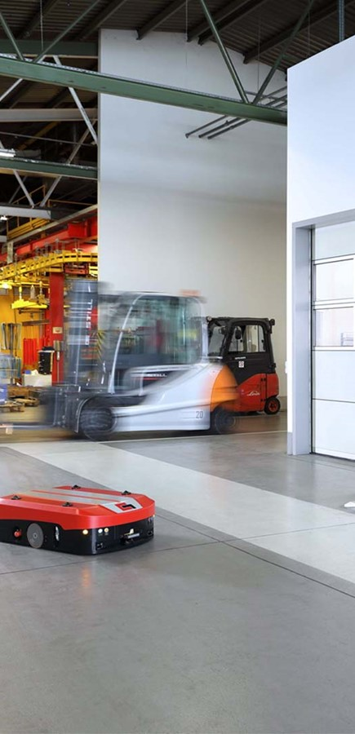

Grenzebach
Case Study
engineering
valantic ensures worldwide planning and optimal customer service at Grenzebach.
  Grenzebach is a family-owned business specializing in plant engineering and automation technology
  It has subsidiaries worldwide in Germany, Belgium, Greece, Romania, the USA, Brazil, China, India and Russia
  The cross-site and cross-functional planning solution, waySuite, has increased efficiency and productivity
  The "baton" concept of valantic's waySuite shortens lead times and increases planning reliability
        All project goals were achieved together
        with valantic.
Notes:
https://www.valantic.com/en/case-studies/grenzebach-plans-and-controls-supply-chain-processes-with-valantics-waysuite/

Slide 75
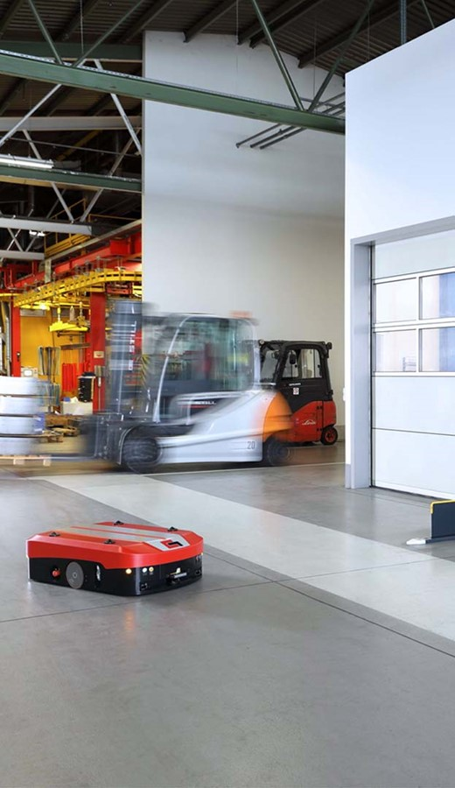
Grenzebach
Case Study
engineering
Grenzebach was looking for an integrated, cross-site and project-overarching planning solution for the entire S&OP process – from order entry and production to assembly and operating.
The “baton” concept is the core of the new planning model. Synchronized supply chain planning with waySuite offers decisive advantages.
Challenge
Consulting approach & technology
Safe, on-time and efficient completion of even challenging multi-plant projects. Time, cost and productivity gains in the entire S&OP process.
Benefits for the customer
Productivity
Time gains
Planning reliability
Notes:
https://www.valantic.com/en/case-studies/grenzebach-plans-and-controls-supply-chain-processes-with-valantics-waysuite/

Slide 76


BBC Cellpack Technology: Swiss precision plastics and metal parts
Case Study
Plastics and metal processing industry
valantic ensures that
BBC Cellpack
Technology always delivers in form.
  BBC Cellpack Technology AG produces high-precision prefabricated plastic and metal parts
  Manual planning processes and data maintenance based on Excel and paper had, however, become inefficient and error-prone
  BBC Cellpack's logistics and value-added processes were substantially optimized by using the Sales & Operations Planning software, waySuite
  Transparent, cross-plant planning now facilitates the handling of stock transfer orders, optimizes inventories and improves the meeting of delivery deadlines
        A cross-plant data basis soon realized tangible benefits.
Notes:
https://www.valantic.com/en/case-studies/multi-plant-planning-with-waysuite-at-behr-bircher-cellpack-bbc/

Slide 77

BBC Cellpack Technology: Swiss precision plastics and metal parts
Case Study
Plastics and metal processing industry
BBC Cellpack’s planning process were ungainly, based on a large number of Excel tools, manual data maintenance and paper. Planning was error-prone due to a lack of transparency and a single source of truth.
The deployment of valantic’s Sales & Operations Planning software, waySuite, has substantially improved planning and optimized the logistics and value creation processes.
Challenge
Consulting approach & technology
Paper and Excel-based works have been reduced. PowerBI is populated using wayRTS data and delivers reliable KPIs. This has led to an improvement in meeting production deadlines and a reduction in inventories.
Benefits for the customer
Reduction in inventories
Meeting of deadlines
Reduction of Administrative expenses
Notes:
https://www.valantic.com/en/case-studies/multi-plant-planning-with-waysuite-at-behr-bircher-cellpack-bbc/

Slide 78


STOLL
Case Study
valantic ensures that processes intertwine smartly at Stoll.
  Stoll has been producing flat knitting machines for over 145 years and is an innovation leader in the field of fashion & technology
  The analysis conducted by valantic identified optimization potential in strategic and operative sourcing as well as in adjoining processes
  Classification of sourced materials and suppliers, fulfillment of deadlines and order quantities
  Development of an optimized sourcing strategy
        Stoll and valantic test innovative sourcing concepts in pilot projects.
Notes:
https://www.valantic.com/en/case-studies/optimization-of-procurement-processes-at-the-knitting-machine-manufacturer-stoll/

Slide 79
STOLL
Case Study
Plastics and metal processing industry
As Stoll’s sourcing strategies, materials planning, interfaces and planning processes are not achieving their maximum potential, a project was launched to identify optimization potential.
ACTUAL analysis and TARGET concept for strategic/operational sourcing and materials planning. valantic develops innovative recommendations for action for more successful sales planning.
Challenge
Consulting approach & technology
The joint project has resulted in enhanced planning efficiency and accuracy, lower costs, increased revenues, the better meeting of deadlines and more satisfied customers.
Benefits for the customer
Planning
Efficiency
Sales success
Notes:
https://www.valantic.com/en/case-studies/optimization-of-procurement-processes-at-the-knitting-machine-manufacturer-stoll/

Slide 80

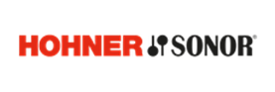
HOHNER/SONOR optimization
Supply Chain Management with wayRTS
Case Study
manufacture and trading
valantic ensures that instrument maker Hohner/Sonor skips to the right beat at.
  Implementation of cross-plant production and supply chain planning
  Introduction of valantic APS's wayRTS software
  Full transparency along the entire value chain
  Improved delivery capability and delivery reliability; reduced time and inventory buffers
  Electronic transmission of worklists and operational data collection
        The corporate beat is right, and the concert can begin!
Notes:
https://www.valantic.com/en/case-studies/hohner-and-sonor-optimize-supply-chain-management-with-wayrts/

Slide 81

HOHNER/SONOR optimization
Supply Chain Management with wayRTS
Case Study
manufacture and trading
Due to the introduction of an international SAP ERP system at HOHNER SONOR and its Taiwanese business partner, the existing APS software also had to be replaced and a new, cross-site planning solution implemented.
The parallel implementation of SAP by a Taiwanese consulting team and of wayRTS by valantic meant that the valantic team was working with “moving goalposts”. The project teams nevertheless worked together successfully, and it emerged that the wayRTS export interface acted as a quality control mechanism for the data migration to SAP.
Challenge
Consulting approach & technology
Full, cross-plant transparency across the value creation process, improved delivery capability and delivery reliability, smaller time/inventory safety buffers.
Benefits for the customer
Notes:
https://www.valantic.com/en/case-studies/hohner-and-sonor-optimize-supply-chain-management-with-wayrts/

Slide 82


thyssenkrupp Materials – Krefeld-based steel and aluminum processing specialist
Case Study
Manufacturing
valantic ensures that the hammer hits the nail on the head at thyssenkrupp.
  Steel and aluminum expert thyssenkrupp migrated its procurement processes from Excel to the cloud
  SAP Integrated Business Planning (IBP) introduced semi-automated sales, procurement and material resource planning to ensure efficiency and transparency
  The outcome was optimized sales, purchasing and MRP planning, as well as mitigated fluctuations in demand and less price pressure
        Integrated cloud-based procurement, sales and material resource planning generates
        real efficiency benefits.
Notes:
Case Study: https://www.valantic.com/en/case-studies/thyssenkrupp-takes-the-leap-to-the-cloud-with-sap-ibp/

Slide 83

thyssenkrupp Materials – Krefeld-based steel and aluminum processing specialist
Case Study
Manufacturing
To migrate the Excel- and template-based procurement planning processes to the cloud and thus leverage efficiency improvements.
SAP IBP cloud solution for integrated, semi-automated sales, procurement and material resource planning.
Challenge
Consulting approach & technology
Transparency and flexibility, enhanced efficiency potentials in sales, procurement and material resource planning as well as mitigated fluctuations in demand and less price pressure.
Benefits for the customer
Notes:
Case Study: https://www.valantic.com/en/case-studies/thyssenkrupp-takes-the-leap-to-the-cloud-with-sap-ibp/

Slide 84
Customer Experience
References

Slide 85
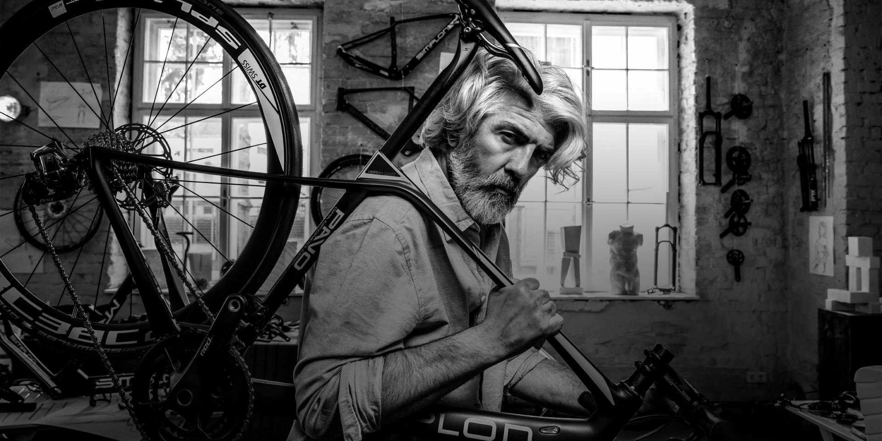

SIMPLON – High-Performance Online Presence
Case Study
BICYCLE MANUFACTURER
valantic ensures that at SIMPLON they work with retailers and consumers in tandem
  SIMPLON manufactures innovative high-end bikes with ingenious technologies and outstanding design.
  An online presence for consumers and an ordering store for dealerships have to meet the highest standards and offer the best possible customer experience.
  The new web store with its dynamic, responsive design leaves nothing to be desired, while performance marketing and social media drive traffic.
        From zero to top gear in record time – KPIs after one year:
        Traffic +70%
        Number of new users +72%
        Number of sessions +72%
Notes:
https://www.valantic.com/en/case-studies/all-round-support-for-simplon/

Slide 86
SIMPLON – High-Performance Online Presence
Case Study
BICYCLE MANUFACTURER
The sale of top-quality bikes with many high-end features required a dazzling online presence; retailers need to be able to place orders quickly and easily via the online store.
A content- and performance-optimized web presence with a responsive design that leaves nothing to be desired. B2B portal, B2C store, social media, newsletter, simplonTV and a magazine drive up traffic.
Challenge
Consulting advice & technology
The high-end website for high-end bikes from valantic paid off from the very start:
  Traffic +70%
  Number of new users +72%
  Number of sessions +72%
Benefits for the customer
Traffic
Customer satisfaction
Customer contacts
Notes:
https://www.valantic.com/en/case-studies/all-round-support-for-simplon/

Slide 87


Group-Wide Customer Typology for Mainzer Stadtwerke
Case Study
Energy Utility
The newly acquired understanding of our customer structure will allow us to leverage many synergy opportunities in the future.
Christian Hoffmann, Head of the Customer & PR Department at Mainzer Verkehrsgesellschaft
  Mainzer Stadtwerke is the regional energy supplier in and around Mainz. 1,700 employees supply over 370,000 residents with electricity, gas, water, heat, public mobility and more.
  Since the company did not have a group-wide view of its customers, it was unable to optimally exploit synergies.
  valantic developed a standardized, group-wide customer typology covering all of Mainzer Stadtwerke’s group companies.
  The uniform understanding of customers has enabled greater customer focus and improved customer satisfaction.
Notes:
https://www.valantic.com/en/case-studies/customer-typology-for-mainzer-stadtwerke/

Slide 88
Group-Wide Customer Typology for Mainzer Stadtwerke
Case Study
Energy Utility
The company did not have a uniform, Group-wide view of its customers, which meant it was unable to exploit synergies in customer support and product development.
valantic’s “Customer Typology Builder” was used to develop a standardized Group-wide customer typology.
Challenge
Consulting approach & technology
Mainzer Stadtwerke was able to develop a uniform understanding of its customers, letting it sharpen its customer focus and exploit existing synergies for cross-selling, product and service innovations, and improved customer satisfaction.
Benefits for the customer
Customer satisfaction
Cross-selling
Product and service innovations
Notes:
https://www.valantic.com/en/case-studies/customer-typology-for-mainzer-stadtwerke/

Slide 89


Höfats – E-Commerce Platform for B2B and B2C
Case Study
HOME accessories
valantic ensures that höfats customers are fired up when visiting its
e-store
  The young design specialist höfats from the Allgäu region in southern Germany offers home accessories for open fires, and from torches to table-top grills.
  Höfats urgently needed an e-commerce platform for end customers and trading partners to fuel further international growth.
  valantic needed just five months to implement a scalable, future-proof online store for B2B and B2C based on a Shopware 6 platform.
  The flexible, state-of-the-art solution ensures a seamless B2B shopping experience, higher B2C conversion rates, and improved efficiency.
Notes:
https://www.valantic.com/en/case-studies/hofats-an-online-store-that-has-it-all/

Slide 90
Höfats – E-Commerce Platform for B2B and B2C
Case Study
HOME accessorIes
Quick implementation of a scalable online store for B2B and B2C that also meets the tax and statutory warranty requirements of international locations.
Hybrid e-commerce solution based on Shopware 6, including interfaces to Xentral (ERP), PayPal, amazon, and Stripe. Processing of all sales channels using a single platform in a stylish online store design.
Challenge
Consulting approach & technology
Optimized shopping experiences for end customers and retail partners; greater efficiency through process automation in the areas of order processing and price and delivery management.
Benefits for the customer
Implementation speed
Customer experience
Efficiency
Notes:
https://www.valantic.com/en/case-studies/hofats-an-online-store-that-has-it-all/

Slide 91


ESA Automates the Testing of Its Online Store
Case Study
WORKSHOP SUPPLIES
“We have integrated the most important recurring test cases into our automated test routines. This saves us an enormous amount of time. And when a test flags an error, developers can investigate it immediately.“
Christine Wälchli, Business Analyst at ESA
  The Swiss purchasing cooperative ESA is a full-range supplier of car and motor vehicle workshops.
  ESA supplies its 10,000 customers with everything that garages, body shops and industry-relevant retail businesses need.
  Regular testing is needed in the context of continuously developing the online shop.
  Automated E2E regression tests were implemented together with the valantic team.
        New store functions can now be tested seamlessly and automatically.
Notes:
https://www.valantic.com/en/case-studies/esa-improves-its-online-store-with-automated-e2e-tests/

Slide 92



ESA Automates the Testing of Its Online Store
Case Study
WORKSHOP REQUIREMENTS
The continuous further development of ESA’s online store needed to be optimized with parallel testing. The aim was to detect errors at an early stage and reduce the amount of manual testing needed.
Automated E2E regression tests were implemented in collaboration with valantic. What this means specifically is that the store is scanned using automated test cases and test robots.
Challenge
Consulting approach & technology
Test automation increases the reliability and quality of software updates. Fewer manual E2E tests are required, which reduces the testing overheads and results is a glitch-free shopping experience.
Benefits for the customer
Implementation speed
Customer experience
Quality
Notes:
https://www.valantic.com/en/case-studies/esa-improves-its-online-store-with-automated-e2e-tests/

Slide 93

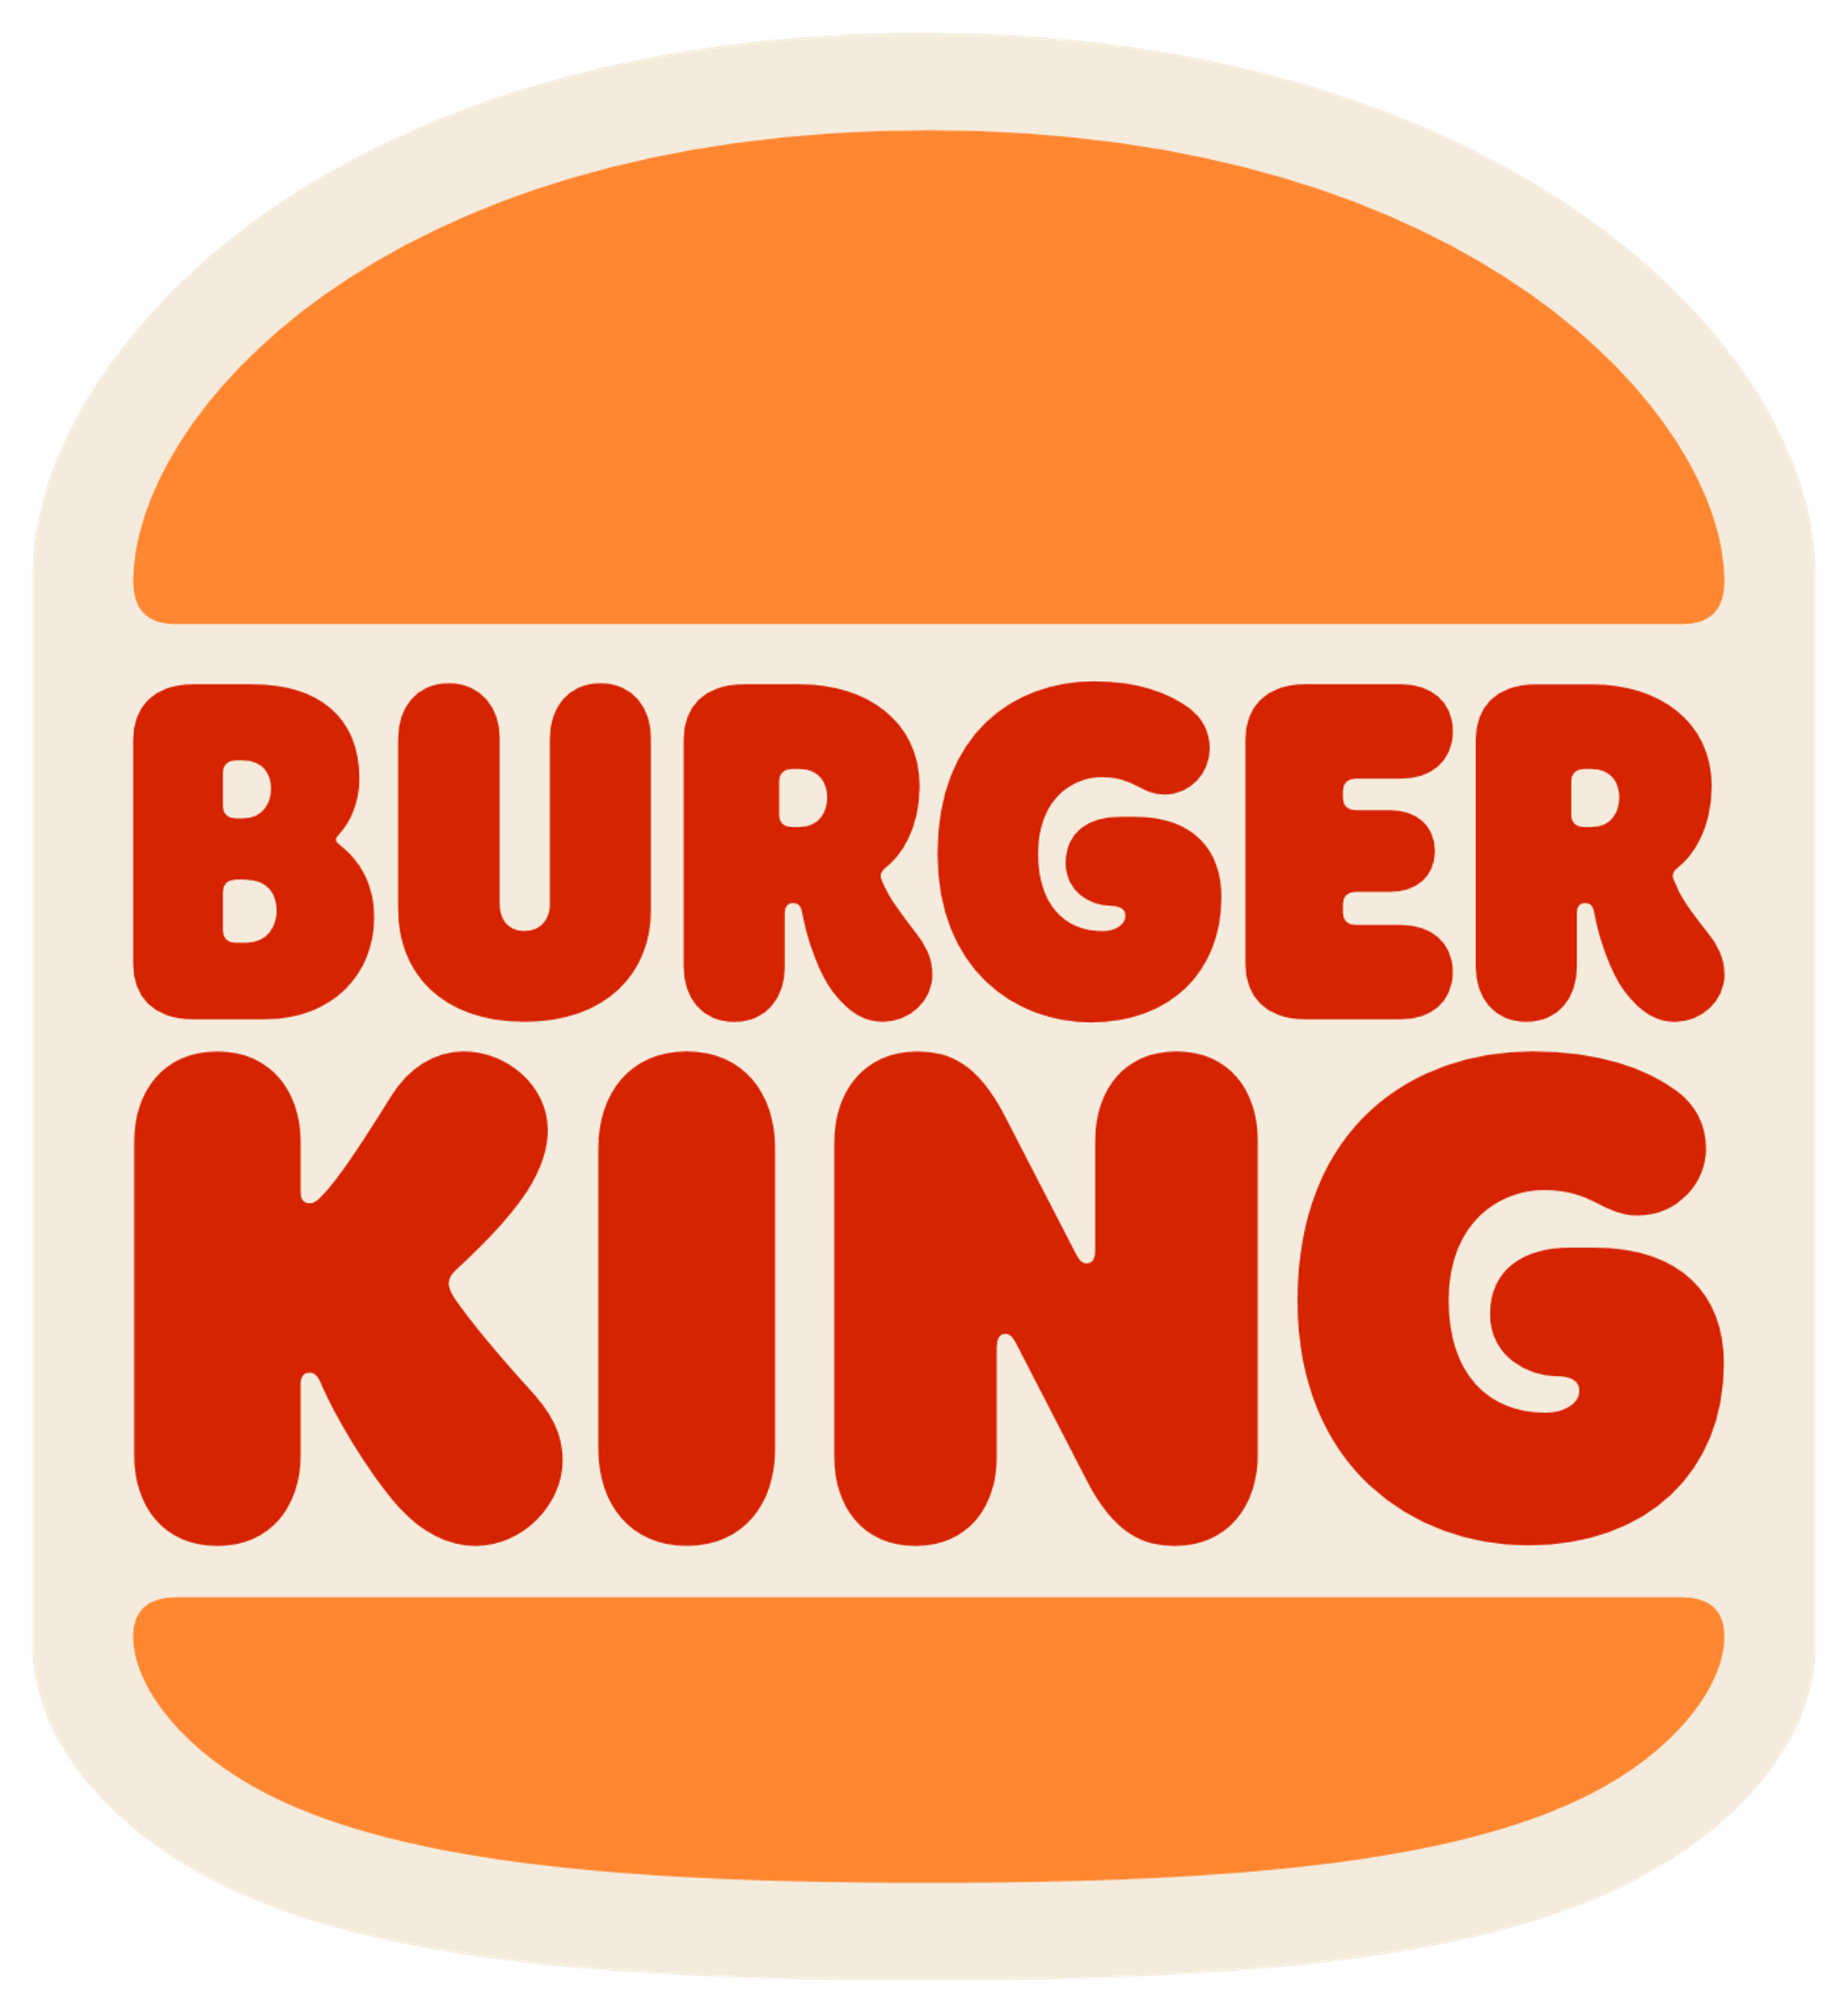
BURGER KING & QSL:
King in E-Commerce
Case Study
FOOD LOGISTICS
Fast Food,
Fast Logistics: valantic ensures BURGER KING savours its ordering processes with relish
        A centralized e-commerce system improves the efficiency of the ordering processes and optimizes the route planning.
  Meyer Quick Service Logistics (QSL) is a food logistics company with more than 900 employees offering services in 20 countries.
  The company, based in Friedrichsdorf near Frankfurt, sources stocks for, and delivers these to, franchise brands such as Starbucks, Burger King, Hans im Glück, Fresh Point and KFC in a one-stop-shop process.
  Together with valantic, QSL has set up a centralized
  e-commerce solution based on Magento 2 for all of
  BURGER KING’s German restaurants.
  With QSL’s new, centralized e-commerce system, ordering processes at BURGER KING have become customizable and can be mapped with maximum efficiency.
Notes:
https://www.valantic.com/en/case-studies/burger-king/

Slide 94

BURGER KING & QSL: King in E-Commerce
Case Study
FOOD LOGISTICS
To develop a high-performance e-commerce system for BURGER KING restaurants, geared towards B2B logistics and system catering. Objective: To map customizable ordering processes with maximum efficiency.
Strategy consulting; Magento 2 serving as the technology platform – based on this, the development of a centralized B2B e-com-merce platform with a bidirectional interface to QSL’s merchandise management system.
Challenge
Consulting approach & technology
Simultaneous processing of > 2,000 orders in a single, high-performance system; optimized route planning; customizable ordering processes; intuitive user interface; outstanding flexibility and scalability.
Benefits for the customer
Customizable for the end customer
Efficiency
Scalability
Notes:
https://www.valantic.com/en/case-studies/burger-king/

Slide 95


Bösch – Cool Online Presence for the Full-Range Supplier
Case Study
HOME TECHNOLOGY
valantic provides for a great atmosphere at Bösch and its customers
  Walter Bösch GmbH is Austria’s market leader for home technology, efficient heating and a pleasant indoor climate.
  It was lacking a modern and inviting website to present and sell its sustainable products.
  valantic completely revamped the company’s website with a responsive design, optimized a large number of content pages, prepared design creatives for the social media channels, and tailored navigation to meet Bösch’s B2C customers’ needs.
        Bösch has taken to the skies. Its online presence and social media have flourished.
Notes:
https://www.valantic.com/en/case-studies/a-state-of-the-art-online-presence-for-bosch/

Slide 96
Bösch – Cool Online Presence for the
Full-Range Supplier
Case Study
HOME TECHNOLOGY
Bösch’s online presence no longer met the company’s or customers’ needs. The eight-year-old design was crying out for a refresh. The configurator for finding heating systems was too complex.
Bösch’s digital transformation strategy was followed by a revamp of its online presence in a responsive design. Navigation is geared towards B2C customers’ needs. Design creatives took social media to the next level.
Challenge
Consulting approach & technology
Social media: Bösch’s engagement rate and page impressions rose as much as 3,600 percent. The website’s ranking improved significantly.
Benefits for the customer
Social media traffic
Website traffic
Website ranking
Notes:
https://www.valantic.com/en/case-studies/a-state-of-the-art-online-presence-for-bosch/

Slide 97

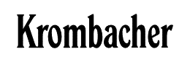
Krombacher Brauerei
Bernhard Schadeberg
Case Study
Beverage
valantic ensures every Krombacher enthusiast now hops digitally from one beer to the next.
  Digitalizing customer interaction is particularly challenging for long-established companies use to traditional sales channels
  The solution: To establish a digital customer relationship based on three initiatives:
    Introduction of data-driven marketing by implementing a Customer Data & Experience Platform (CDXP by Bloomreach)
    Integration of the customer service contacts using Salesforce CRM
    Creation of customer value add through a loyalty & feedback program
        This way, beer now also tastes great digitally!

Slide 98

Krombacher Brauerei Bernhard Schadeberg
Case Study
Beverage
Existing distribution chains decoupled Krombacher from their consumers through multi-level sales constructs.
Consulting approach & technology
Challenge
Implementing the Bloomreach Customer Data & Experience Platform and the high-performance interface to the Salesforce Service Cloud based laid the foundation for state-of-the-art brand relationships.
Benefits for the customer
The digitalization strategy enabled direct customer relationships across all phases of the lifecycle. This resulted in greater independence from retail and distribution and improved online sales.
Higher sales in the online store
Newsletter subscriptions
New customers via
“Krombacher Friends Program”

Slide 99


DELTA-V
Case Study
Office furniture & fittings
valantic ensures customers now order elegant office furniture more dynamically than a quick-drawer.
  DELTA-V is a German B2B retailer of elegant,
  office furniture that is designed in-house
  The sales department relies systematically on one-stop shopping for e-commerce
  The design and functionality of the Oxid 6 store were tuned for perfect performance
  Simultaneous implementation of the Oxaion ERP system and eggheads PIM system
  The new “Fact-Finder Next Generation” search feature helps users select office furniture intelligently and dynamically
        Our vision: The future belongs to digital direct sales.

Slide 100
DELTA-V GmbH
Case Study
Office furniture & fittings
Complete relaunch of the store system, optimization of the design, functionality and customer experience, customer-friendly search feature for shoppers, and powerful, fine-grain offer analytics and optimization.
Takeover, reprogramming and customization: Oxid 6 store system, Oxaion ERP solution, “Fact-Finder Next Generation” search feature, eggheads PIM system, New Relic for offer analytics and optimization.
Challenge
Consulting approach & technology
Significant, dynamic and flexible performance optimization of the digital sales functionality, professional project management: everything went like clockwork.
Benefits for the customer
User-friendliness
Search quality
Customer-satisfaction

Slide 101

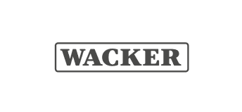
Wacker Chemie
Case Study
Chemicals
valantic ensures that, at Wacker, the chemistry’s right with its customers.
  Wacker Chemie operates internationally and offers 3,200 technology-leading products for every key global industry
  valantic raises Wacker's customer experience to a state-of-the-art "next level"
  Performance, sales and customer satisfaction are rising sharply
  100 percent customer focus – 100 percent performance, with SAP Commerce Cloud
        Chemistry is when everything works just perfectly and seamlessly meshes: optimal sales success.

Slide 102

Wacker Chemie
Case Study
Chemicals
An archaic web store and cumbersome customer portal could not fully exploit sales and CX potential.
A customer survey provided valuable key aspects. valantic planned and implemented a global, state-of-the-art digital commerce solution based on SAP Commerce Cloud.
Challenge
Consulting approach & technology
Immense performance gains, enhanced scalability, lower costs, and greater transparency and sales success.
Benefits for the customer
Performance
Sales success
Customer satisfaction
Notes:
/

Slide 103

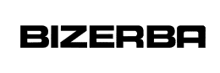
Bizerba
Case Study
Mechanical engineering – precision mechanics
valantic ensures that, at Bizerba, every quotation is engineered to perfection.
  Bizerba is a supplier of cutting and weighing technology and also offers a comprehensive solution portfolio of hardware, software and services
  Since every customer is unique, they should also receive made-to-measure quotations
  The integrated CRM, ERP and SAP CPQ IT landscape has immensely simplified the preparation of quotations
  Thanks to SAP CPQ, a single, clear and customized quotation document can be created at the touch of a button.
        Customer satisfaction has risen and sales staff workloads minimized.

Slide 104

Bizerba
Case Study
Mechanical engineering – precision mechanics
Sales employees were often occupied for long periods of time with preparing individual customer quotations. Bizerba wanted an integrated quotation tool to be able to offer easily the right solutions.
Data are exchanged bidirectionally. Further information is also imported into CPQ over the interface to Microsoft Dynamics 365. When a quotation is created, all the data are transferred to the SAP CPQ system.
Challenge
Consulting approach & technology
Hardware and software products, as well as consumables and services, are incorporated in a single quotation. The sales department can prepare quotations much more efficiently, resulting in significant cost savings.
Benefits for the customer

Slide 105


Melitta
Case Study
Food & Beverage
valantic ensures perfect coffee indulgence – both online and offline.
  Melitta is world famous for the invention of the patented coffee filter. But its product range meanwhile extends far beyond that
  International eCommerce: Melitta wanted an emotional shopping experience across all devices and brands
  It wanted to be able to implement target-group and season-specific promotions such as vouchers, subscriptions and bundles with a minimum of effort
  valantic's eCommerce platform Shopware meets all these requirements with flying colors
        Melitta and valantic offer NextGen coffee indulgence “at its best”.

Slide 106
Melitta
Case Study
Food & Beverage
Melitta was looking for an internationally deployable eCommerce solution that is suitable for marketing and sales across all devices and brands and enables lower monthly costs for operating and development.
valantic’s Shopware shopping platform with efficient sub-shop logic and middleware admirably maps all of Melitta’s requirements and can be easily integrated into the system via the Shopware API.
Challenge
Consulting approach & technology
Melitta purchasing managers can present their products with just a few clicks, and can quickly and easily configure discount promotions, coupons, bundles and much more using Shopware’s standard plug-ins.
Benefits for the customer
Sales
Reduction of Costs and effort
Customer satisfaction

Slide 107
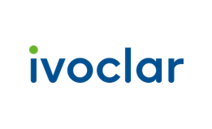
IVOCLAR
Case Study
Life Science
valantic ensures that Ivoclar brings a smile to its customers’ faces.
  Ivoclar is an internationally successful family-owned dental company from Liechtenstein with 3,500 employees worldwide
  The sale of innovative solutions for dentists, dental technicians and dental hygienists requires intensive consultation
  Ivoclar offers its customers an e-learning portal informing about the professional use of its solutions
        valantic implemented a central platform for all that is needed to optimize the customer experience and minimize administrative overheads.

Slide 108
IVOCLAR
Case Study
Life Science
To create a central digital platform that combines content, commerce and community for all 130 sales countries, is fully integrated into the IT environment and automates administrative tasks.
Benefit-oriented prioritization of requirements, agile design and development of a solution with Pimcore as the global CMS for the website and Academy, as well as integrated e-commerce based on SAP Commerce Cloud.
Challenge
Consulting approach & technology
A central platform for 36 local websites, the
e-commerce area and the Academy optimizes the customer experience. System integration and minimized administrative overheads free up staff capacities for consulting and sales.
Benefits for the customer
Administrative effort
System integration
Customer experience

Slide 109

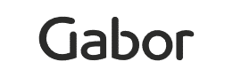
GABOR
Case Study
Fashion
valantic ensures
Gabor’s online shoppers are always one step ahead of the rest.
  Gabor is a long-established brand that stands for high-quality shoes. The manufacturer is headquartered in Rosenheim near Munich
  The retail-intensive sale of its shoes was to be upgraded into an innovative e-commerce network
  70 retailers were to be connected to the online marketplace over an interface
  The open-source solution, Pimcore, meets all requirements and offers long-term financial benefits
        Thanks to valantic and Pimcore, the Gabor online store now offers excellent customer experiences.

Slide 110

GABOR
Case Study
Fashion
The legacy e-commerce infrastructure was to be upgraded into an innovative online marketplace and connect 70 Gabor retailers over a single interface.
SAP CDC enables unambiguous customer identification for central registration, single sign-on, and 360-degree customer visibility, paving the way for marketing automation and progressive profiling.
Challenge
Consulting approach & technology
Excellent shopping experience and manifold opportunities to continuously develop the online marketplace.
Benefits for the customer
Cost benefits
Further development opportunities
Shopping experiences
Notes:
/

Slide 111
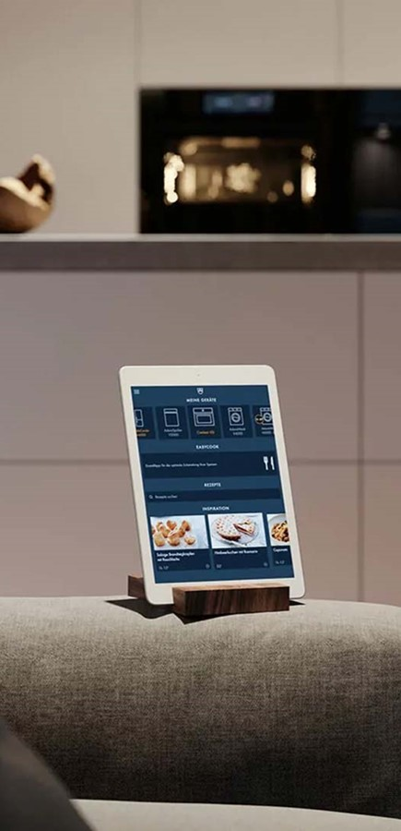

V-ZUG
Case Study
Household appliances
valantic ensures that
V-ZUG customers can physically enjoy its
digital services.
  V-ZUG is Switzerland's market leader for household appliances and has been manufacturing premium solutions for cooking, dishwashing and washing for over 100 years
  A single sign-on should give customers access to V-ZUG's entire digital world
  A detailed, holistic evaluation of a solution was conducted
  Together with valantic, V-ZUG implemented a central customer identity and access management system based on SAP Customer Data Cloud (SAP CDC)
        V-ZUG and valantic create a customer-
        centric, future-oriented CIAM platform.

Slide 112
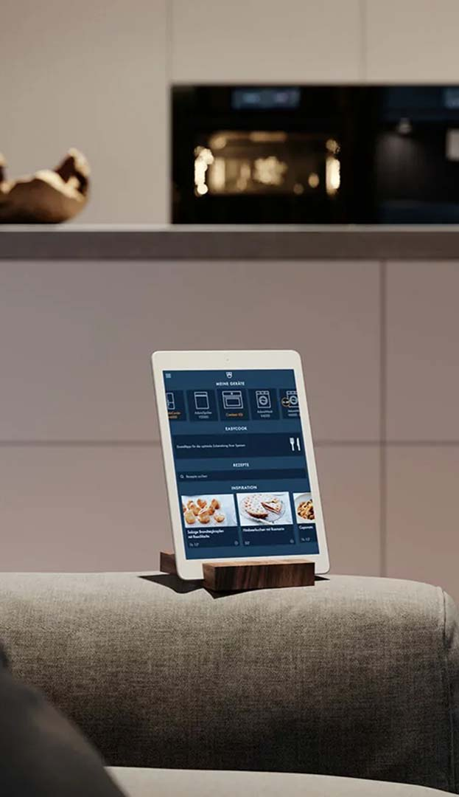
V-ZUG
Case Study
Household appliances
To provide simple, uniform and convenient customer access to V-ZUG’s digital world while complying with international data-protection and security requirements.
SAP CDC enables unambiguous customer identification for central registration, single sign-on, and 360-degree customer visibility, paving the way for marketing automation and progressive profiling.
Challenge
Consulting approach & technology
Unique customer experience that combines unique selling propositions of high-end devices from the physical world with customer touchpoints in the digital world.
Benefits for the customer
Security
Future viability
Customer orientation

Slide 113
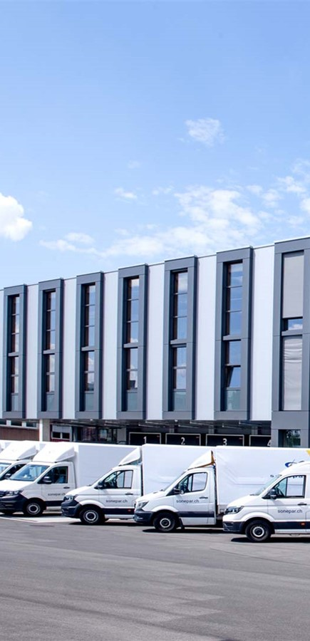

Sonepar Suisse: The number 1 in Swiss electrical wholesaling
Case Study
Electrical wholesaling
valantic ensures that Sonepar Suisse’s customers don’t sit in the dark.
  Sophisticated navigation concept: 220,000 articles presented in a user-friendly format
  CombiTool: Any grouping of switches can be combined and ordered individually with a click or drag & drop
  Power Features: Similarly to ERP systems, customers can view their merchandise management and order history at any time
  Corporate & Commerce: The two areas merge harmoniously on a single page
        Innovative Spryker online platform for the Swiss electrical wholesale trade.
Notes:
https://www.valantic.com/en/case-studies/b2b-platform-for-sonepar-suisse/

Slide 114
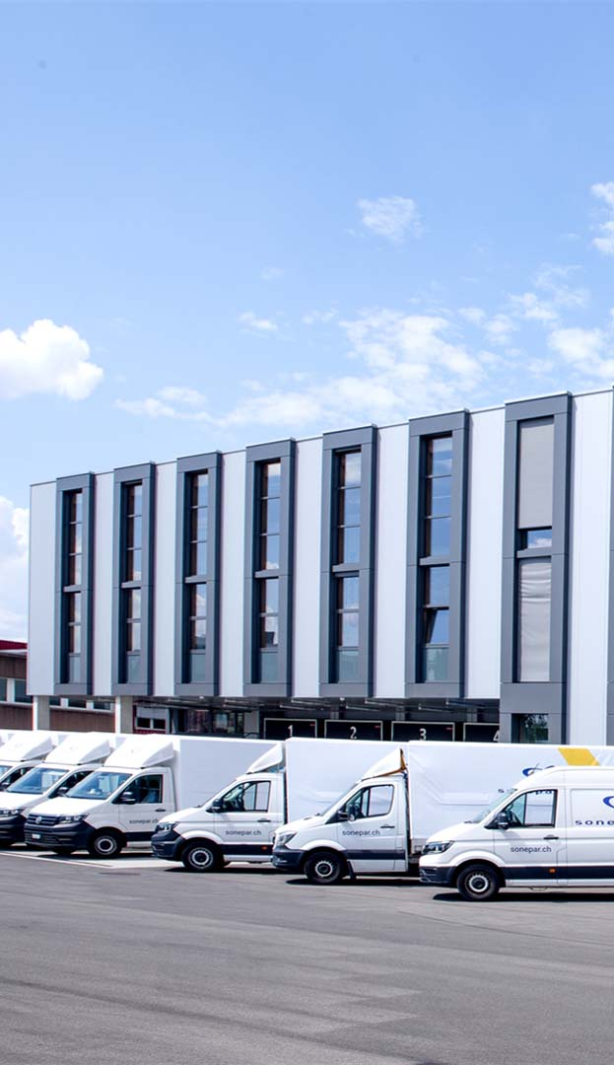
Sonepar Suisse: The number 1 in Swiss electrical wholesaling
Case Study
Electrical wholesaling
Many of Sonepar Suisse’s customers do not hold their own inventories, thereby making the ability to order quickly, easily and intuitively a top priority.
Comprehensive consulting based on customer interviews and workshops with management, marketing, sales and product management. Support in the area of designing and preparing content. Development of a 3- to 5-year roadmap. Platform-as-a-Service solution from Spryker with more than 900 API-based modules.
Challenge
Consulting approach & technology
The optimization of the CombiTool and new navigation concept with a one-click philosophy will allow Sonepar Suisse’s customers to achieve their goals even faster. As an ERP-like construct, the B2B platform provides for full order transparency and offers reliable tools for customized self-management.
Benefits for the customer
Notes:
https://www.valantic.com/en/case-studies/b2b-platform-for-sonepar-suisse/

Slide 115
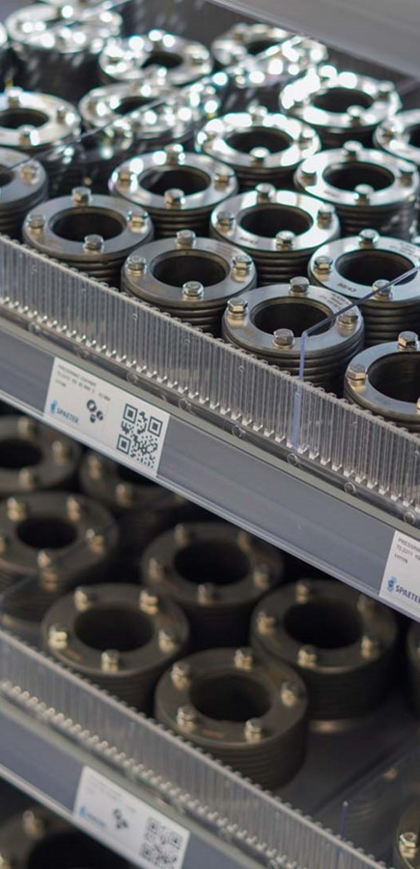

Spaeter: Swiss construction-supplies wholesaler
Case Study
Construction
valantic ensures that Spaeter’s customers are on the right track.
  Spaeter takes the customer experience to the next level with an augmented shop experience
  The flagship store in Lucerne (Switzerland) can be accessed by customers 24/7
  Customers access the store via the Spaeter app
  Augmented reality navigation guides customers to the desired product which can be added directly to the shopping cart using the scan-to-basket feature
        Purchases can be paid for directly and contactlessly using the self-checkout feature.
Notes:
https://www.valantic.com/en/case-studies/spaeter-counts-on-augmented-shop-experience-with-pimcore/

Slide 116
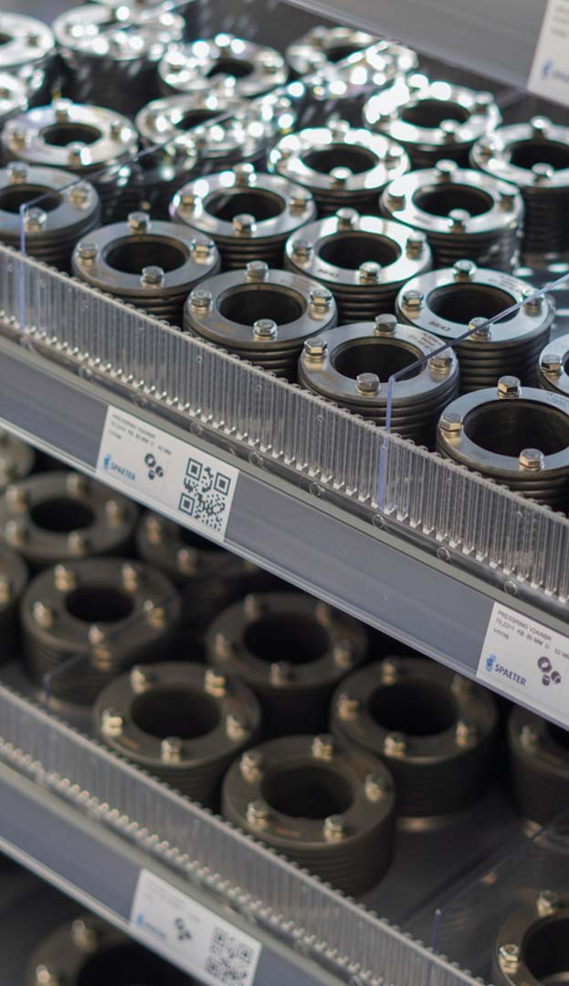
Spaeter: Swiss construction-supplies wholesaler
Case Study
Construction
To implement a pickup store that is open to customers around the clock and allows customers to find their way around even without sales staff.
Optimized customer experience thanks to Pimcore: A map forms the core of the augmented reality navigation, providing a graphical depiction of the store’s shelves. Inaccessible zones and obstacles are also marked. A coordination system transmits the corresponding data to the app. A visual editor provides for user-friendly updating of the map.
Challenge
Consulting approach & technology
Unrestricted temporal access to the products. Autonomous location and pickup of the desired items. Contactless shopping and payment.
Benefits for the customer
Notes:
https://www.valantic.com/en/case-studies/spaeter-counts-on-augmented-shop-experience-with-pimcore/

Slide 117
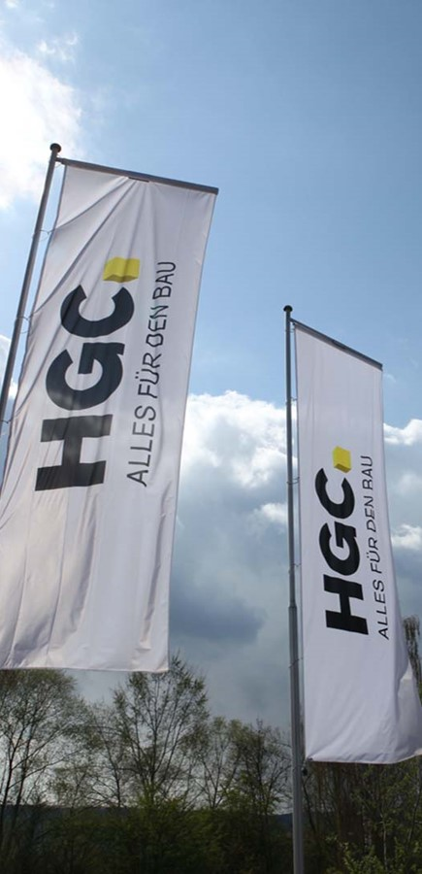

HG COMMERCIALE, the Swiss service provider for all construction matters
Case Study
Construction
valantic ensures that customers can now build on HGC.
  New building-material online store and inspiration for wall and floor coverings combined in a single platform
  Complex user management: Multi-user with different authorizations and use cases
  Unit calculator: How many packaging units are required for which area?
  Ordering via company lists
  Customer-specific prices: List price, net price and individual discount issued item-specifically
        Smart e-commerce & corporate platform with SAP Commerce Cloud for HGC.
Notes:
https://www.valantic.com/en/case-studies/hgc-relies-on-sap-commerce-cloud/

Slide 118
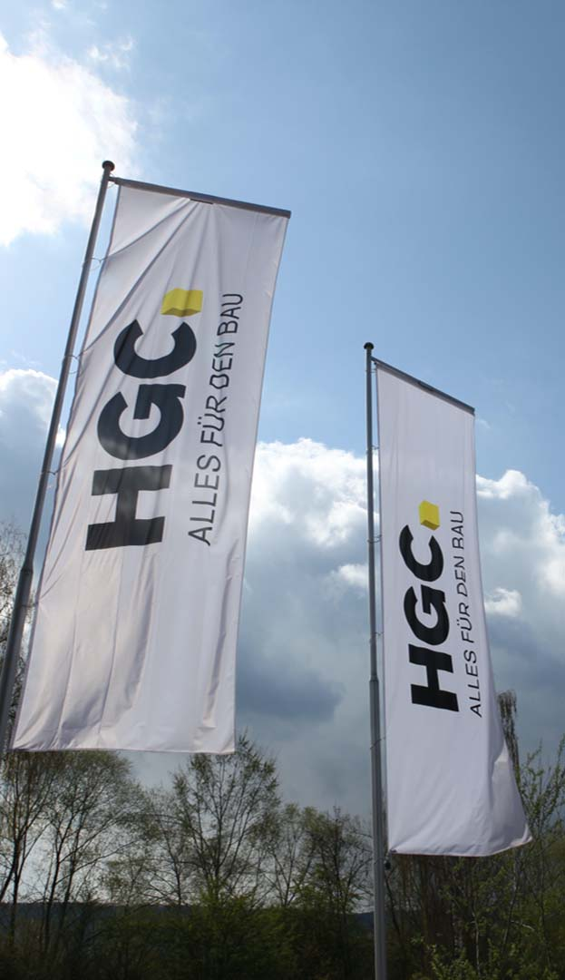
HG COMMERCIALE, the Swiss service provider for all construction matters
Case Study
Construction
The individual requirements of very different target groups had to be met in the best possible way and integrated into the new platform.
Usability, technology, digital commerce and productivity – four focal topics that HGC and valantic tackled together. SAP Commerce Cloud serves as the reliable technological basis.
Challenge
Consulting approach & technology
Sector-specific inspiration and information. Optimized registration and ordering pro-cesses. Personalized service solutions in the Buying Center. The process for onboarding went from two weeks to just four hours.
Benefits for the customer
Reduction of processing times
Automated order processing
Platform quality & stability
Notes:
https://www.valantic.com/en/case-studies/hgc-relies-on-sap-commerce-cloud/

Slide 119


Mobile CRM and PIM app provides for mobilization of the international sales force
Case Study
GROCERIES
valantic ensures that Aryzta always knows “which side its bread is buttered”.
  Introduction of a mobile SAP CRM solution at globally active foodstuffs producer, Aryzta
  Clear customer focus by providing the sales force with online and offline access to all vital
  customer data
  The CRM app enables campaign and opportunity management as well as offer creation at the
  point of sale
  Aryzta uses a Product Information Management (PIM) app instead of a catalog
        Interface to internal SAP systems ensures a more efficient ordering and sales process.
Notes:
Case Study: https://www.valantic.com/en/case-studies/aryzta-food-europe-new-momentum-for-the-international-sales-force/

Slide 120
Mobile CRM and PIM app provides for mobilization of the international sales force
Case Study
GROCERIES
Optimal support of Aryzta’s customers – including large organizations such as Coop or Tesco as well as local bakeries, hotels and retailers – by the international sales force.
Introduction of an SAP-based CRM and PIM solution as a mobile app including an interface to the legacy IT ecosystem and integration into the SAP backend systems; the deployed technologies include SAP CRM (Sales & Marketing), SAP Hybris Cloud for Customer, SAP mobile BI, SAP Customer Insight and SAP NetWeaver Process Integration.
Challenge
Consulting approach & technology
The app guarantees all departments smooth sales and ordering processes as well as uncomplicated work at the point of sale. The preparation of product presentations is simplified, and individual price and discount promotions are made possible by the integrated campaign and opportunity management functionality.
Benefits for the customer
Notes:
Case Study: https://www.valantic.com/en/case-studies/aryzta-food-europe-new-momentum-for-the-international-sales-force/

Slide 121

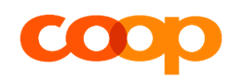
Overall project management and coordination of the relaunched coop@home commerce platform
Case Study
Grocery retailing
valantic ensures that only the freshest goods are served at Coop customers’ tables.
  valantic ensures a unique shopping experience with an award-winning linking of offline and
  online business
  8.5 million Swiss online shoppers benefit from the innovative grocery platform
  valantic assumed responsibility for the overall project management including the backend development for SAP Hybris, design and frontend development and the mobile app
        Recognized with the Digital Commerce Champion 2020 award.
Notes:
https://www.valantic.com/en/case-studies/coop-at-home-new-sales-platform-on-sap-hybris/

Slide 122

Overall project management and coordination of the relaunched coop@home commerce platform
Case Study
Grocery retailing
Coop has been offering online grocery shopping for 15 years. valantic supported the company in relaunching its existing plat-form and in redeveloping the mobile, oper-ating system-independent commerce app.
The project was kicked off with surveys and usability tests to analyze shopping behavior and thus create an optimal customer experience. This was followed by the development of a revamped design and new store GUI.
The mobile app for iOS and Android was also redeveloped and covers all the functions of the web version.
The app was connected to the SAP Hybris Commerce platform, to the App Store and also to web services and is based on Appcelerator technology.
Challenge
Consulting approach & technology
Based on the SAP Commerce Cloud valantic has fully overhauled the coop@home online store, both technologically and visually. Coop was recognized with the Digital Commerce Champion 2020 award for this.
Benefits for the customer
Notes:
https://www.valantic.com/en/case-studies/coop-at-home-new-sales-platform-on-sap-hybris/

Slide 123

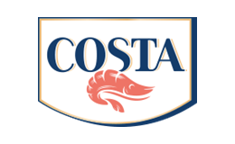
Mobile store check for COSTA ensures optimized assortment presentation
Case Study
Food production
valantic ensures that COSTA customers always have better fish to fry.
  Development of a mobile solution for COSTA's sales force based on the SAP Cloud for Customer system
  Sales force staff check the positioning of COSTA's products at the point of sale and capture the data directly in the SAP system via their mobile devices instead of on paper (as was previously the case)
  Manual processes could be reduced, the data are captured on site in the cloud system where they become directly available for further evaluations
        Optimized sales and immediate optimization of presentation and positioning are possible.
Notes:
Case Study: https://www.valantic.com/en/case-studies/mobile-store-check-in-sap-cloud-for-customers-for-costa/

Slide 124

Mobile store check for COSTA ensures optimized assortment presentation
Case Study
Food production
Successful product sales at supermarkets rely on the products being clearly visible and available in sufficient quantities at all times. This is because only optimized assortments generate more turnover. COSTA employees ensure this by regularly checking the positioning of their products in the store, but captured the results using paper-based forms in what was a highly manual process.
valantic developed a mobile store check in SAP Cloud for Customer, together with COSTA. COSTA employees check the assortment in the supermarket and capture the data in the mobile system, on the spot.
Challenge
Consulting approach & technology
Reduction in manual processes: Data are captured on the move, processed directly in the cloud system and are immediately available for further evaluations and historical comparisons. Products can be reordered immediately, and product presentation and positioning optimized on site.
Benefits for the customer
Notes:
Case Study: https://www.valantic.com/en/case-studies/mobile-store-check-in-sap-cloud-for-customers-for-costa/

Slide 125
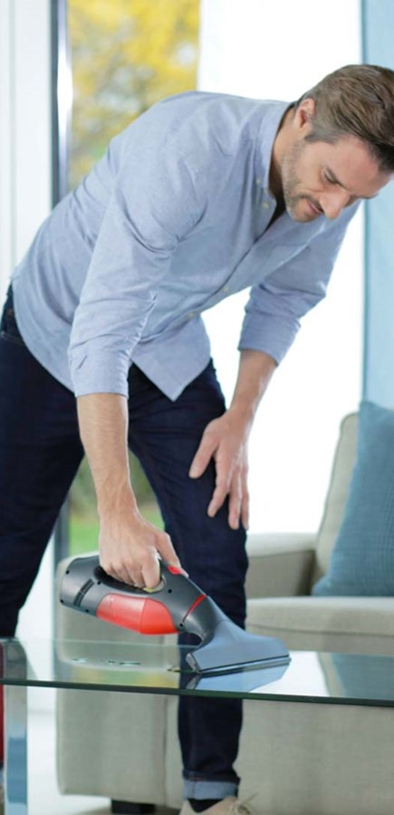
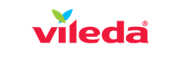
Vileda – A leading brand supplier of cleaning systems
Case Study
Consumer goods
valantic ensures that Vileda cleaning products are quickly at hand around the world.
  Central platform for B2B and B2C customers for all locations and brands worldwide in 30 countries
  Solution based on SAP Commerce Cloud with virtual meeting rooms, integrated payment service providers, ticketing and SAP ERP interface
  Uniform content management and modern stores for an inspiring shopping experience
        Higher conversion rates, better business results – a global solution communicates content perfectly to an international clientele.
Notes:
Case Study: https://www.valantic.com/en/case-studies/vileda-b2b-b2c-platform-with-the-sap-commerce-cloud

Slide 126
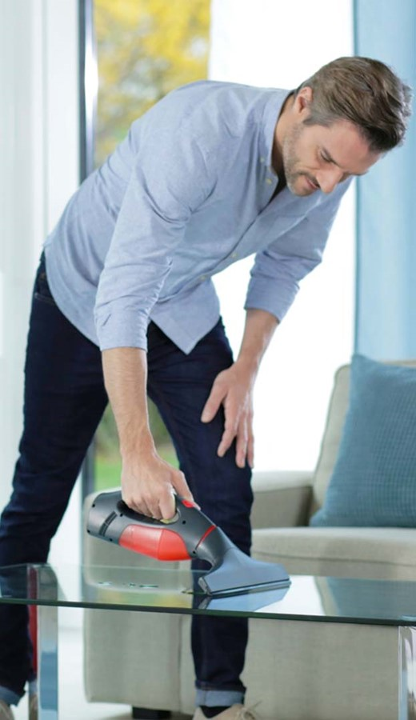
Vileda – A leading brand supplier of cleaning systems
Case Study
Consumer goods
An integrated platform for worldwide brand positioning which optimally implements the requirements of each country and brand.
SAP Commerce Cloud offers a good balance between content, store and positioning for B2C and B2B.
Challenge
Consulting approach & technology
An integrated, future-proof solution for seamlessly modeling all relevant end-to-end processes.
Benefits for the customer
Notes:
Case Study: https://www.valantic.com/en/case-studies/vileda-b2b-b2c-platform-with-the-sap-commerce-cloud

Slide 127


HERO AG
Case Study
Groceries
valantic ensures that Hero’s salespeople always offer their customers appetizing advice.
  Hero is a long-established company and a classic among Swiss brands that stands for the "Flavorsome preservation of fresh products"
  Hero employs approximately 4,300 people in 16 countries
  The multilingual mobile app from valantic is the ideal companion for sales consultants
  The app helps optimally prepare for customer visits
  It is an elegantly designed, feature-rich solution
        The mobile Hero app lets salespeople better consult their customers.
Notes:
https://www.valantic.com/en/case-studies/mobile-app-for-hero-sales-advisors/

Slide 128

HERO AG
Case Study
Groceries
For customer consultations and presentations, preparation is half the battle. Hero’s consultants, however, lacked the latest information about the customer and data from the CRM/ERP.
valantic developed an elegant, mobile all-round info app for consulting and sales based on Spryker Commerce OS, including SAP integration, sales website and CMS.
Challenge
Consulting approach & technology
valantic developed an elegant, mobile all-round info app for consulting and sales based on Spryker Commerce OS, including SAP integration, sales website and CMS.
Benefits for the customer
Quality of consulting
Sales
Customer satisfaction
Notes:
https://www.valantic.com/en/case-studies/mobile-app-for-hero-sales-advisors/

Slide 129


THERMOPLAN – Coffee bliss par excellence
Case Study
Engineering
valantic ensures that THERMOPLAN’s coffee specialties arrive fresh in the cup anytime anywhere.
  Conception and development of the worldwide communication platform "myThermoplan" for all employees and service technicians
  User-friendly dashboards with very appealing, responsive designs
  All technical information, training offers, e-learning, marketing, communication, documents and media at a glance
  Simple single sign-on
        A state-of-the-art platform that increases process efficiency and offers service technicians quick and easy assistance.
Notes:
https://www.valantic.com/en/case-studies/new-service-portal-for-thermoplan/

Slide 130

THERMOPLAN – Coffee bliss par excellence
Case Study
Engineering
To make information, news, online training, documents and know-how accessible to all service technicians and employees worldwide.
To implement strategy workshops with user stories, interviews, design prototypes, two proofs of concepts and a single sign-on portal.
Challenge
Consulting approach & technology
A central communication platform with custom dashboards that increases efficiency through exemplary integration into the process ecosystem.
Benefits for the customer
Quality of consulting
Sales
Customer satisfaction
Notes:
https://www.valantic.com/en/case-studies/new-service-portal-for-thermoplan/

Slide 131
Further references

Slide 132


SIGNAL IDUNA Group
Case Study
Insurance
valantic ensures that over 12 million SIGNAL IDUNA customers feel safe.
  Replacement of IBM Notes – porting of form-based workflows to a future-proof web platform
  "Icebreaker forms" and a customized framework application for a quick start
  High recognition value – changes for users kept to a minimum
  Building blocks for recurring tasks – quick and easy development of new forms
        SIGNAL IDUNA was highly satisfied – valantic was awarded a follow-up project in which it is responsible for the further development of the Form Center.
Notes:
https://www.valantic.com/en/case-studies/reimplementation-of-an-ibm-notes-legacy-application-for-signal-iduna/

Slide 133
SIGNAL IDUNA Gruppe
Case Study
Insurance
To replace IBM Notes with a Web platform and re-engineer the form-based workflow.
High recognition value of the new web apps for users.
Technologies: JEE, WebSphere, jBPM, Hibernate, Groovy, AngularJS.
Challenge
Consulting approach & technology
State-of-the-art technology with familiar operation and framework for the quick creation of future forms.
Benefits for the customer
Notes:
https://www.valantic.com/en/case-studies/reimplementation-of-an-ibm-notes-legacy-application-for-signal-iduna/

Slide 134
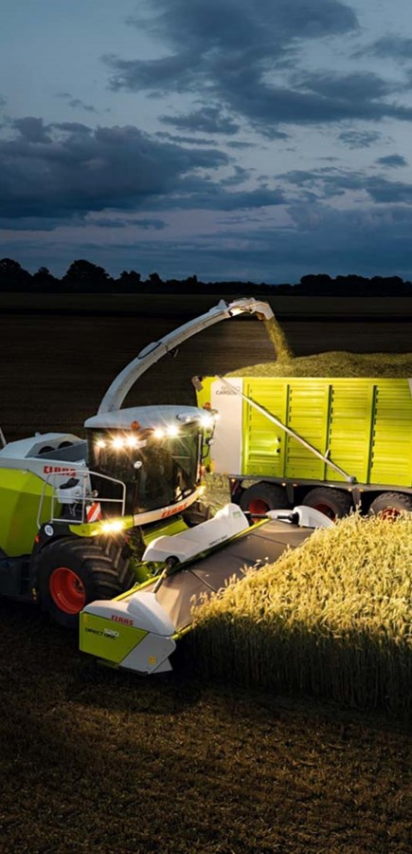
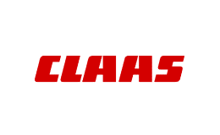
Setup of, and migration to, a cutting-edge e-mail infrastructure for 9,000 employees
Case Study
Engineering
valantic ensures that the e-mails arrive at CLAAS.
  E-mail migration from IBM Notes to MS Exchange
  Setup of a customized e-mail infrastructure based on Microsoft Exchange
  Migration of 9,000 seats at 30 locations in 17 countries
  Smooth migration during ongoing operations
  The switchover to the new e-mail infrastructure enabled significant savings to be realized in the area of licenses
        CLAAS now operates in a future-proof IT ecosystem with capacity for growth.
Notes:
https://www.valantic.com/en/case-studies/mail-migration-from-notes-to-exchange-for-claas/

Slide 135
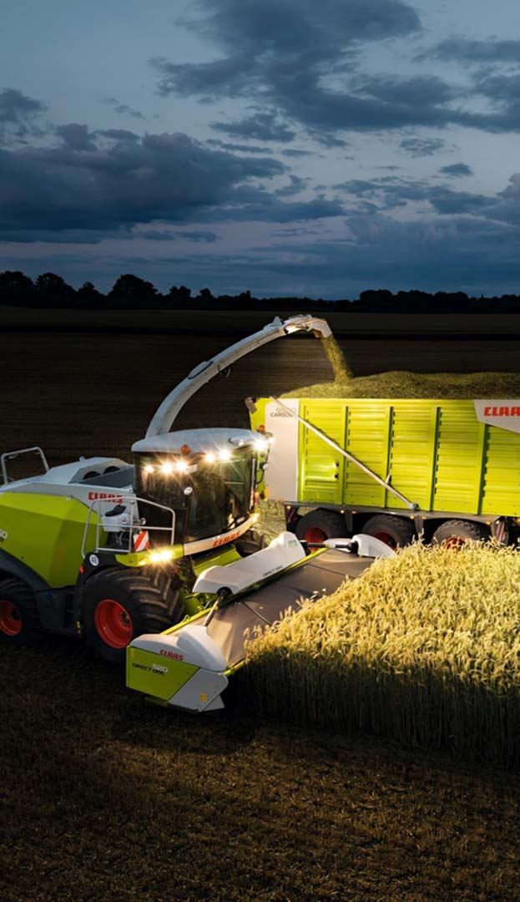
Setup of, and migration to, a cutting-edge e-mail infrastructure for 9,000 employees
Case Study
Engineering
Around 9,000 Lotus Notes Domino users had to be migrated to a new Microsoft Exchange infrastructure...without interruption to ongoing operations.
In the initial phase, the new target infrastructure defined, and a customized
e-mail infrastructure based on Microsoft Exchange was set up. This was followed by the migration of approximately 9,000 seats.
Challenge
Consulting approach & technology
Besides massive savings in licensing costs for the e-mail infrastructure, the new Exchange infrastructure is future-proof and scalable and will continue to operate smoothly, even with 15,000 users.
Benefits for the customer
Notes:
https://www.valantic.com/en/case-studies/mail-migration-from-notes-to-exchange-for-claas/

